Slide 1

Mandatory Orientation and Safety Training for New
Adopt-A-Waterway (AAW)
Group Leaders
Continue

Slide 2

Introduction
In the Adopt-A-Waterway program, your group is an important part of an overall community-based plan to:
Reduce litter by helping to keep our waterways clean
Raise public awareness about the costly and unsightly problem of litter.
“There are more than 26 billion pieces of litter along our nation’s waterways with most (88%) being four inches or smaller in size!”
- Keep America Beautiful
Continue

Slide 3
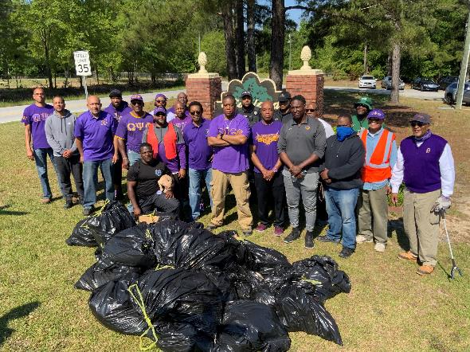
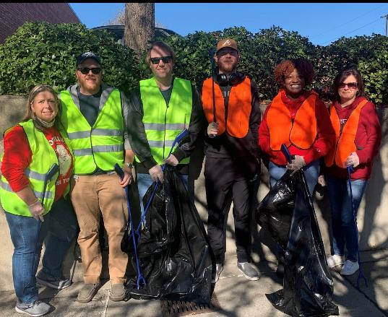
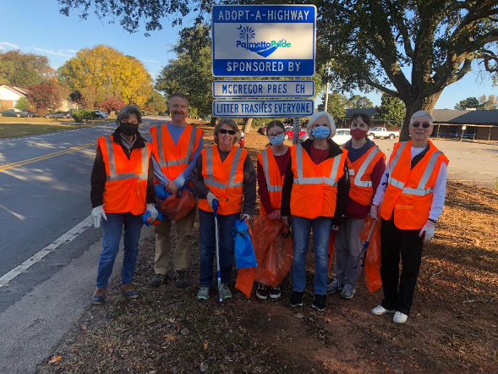
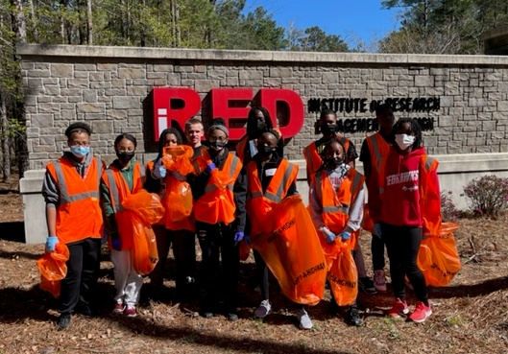
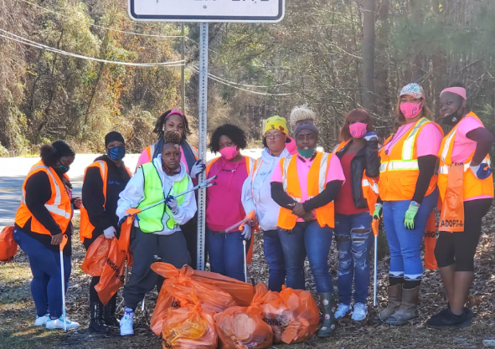
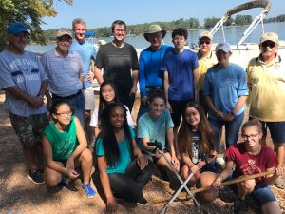
In 2025, 6,737 volunteers from 290 groups in Lexington and Richland counties helped Keep the Midlands Beautiful by removing 217,964 pounds of litter. Of these, 80 groups participated in the AAW program.
Continue

Slide 4






Our Mission and Partners
The mission of Keep the Midlands Beautiful is to engage, inspire, and educate the Midlands to invest in our community through litter prevention, recycling, and beautification.
KMB is a 501 (c) (3) organization supported by:
Adopt-A-Highway, Adopt-A-Street and Adopt-A-Waterway Partners:
Continue

Slide 5
Learning Objectives
By the end of this training, you will be able to:
Identify Group Leader responsibilities that occur prior to, during, and after group cleanups
Facilitate a safe group cleanup day by applying AAW safety policies and procedures.
and
Continue

Slide 6
Safety & Orientation Training Topics
Click Here
AAW Program
Group Leader Responsibilities
Safety First
Cleanup Day Policies and Procedures

Slide 7
AAW Program: Your Commitment
Agreement Form
Keep a copy of your signed agreement form at all times.
Link to AAW Agreement Form
Program Commitment
This program is a TWO-year commitment.
At the end of your two-year commitment period, if you choose to renew, you are required to complete a new agreement form.
Reporting Requirements
You are required to submit a report card after EACH cleanup.
Failure to report two consecutive cleanups results in a breach of agreement, and your group could be dropped from the program.
Link to Report Card
Continue

Slide 8
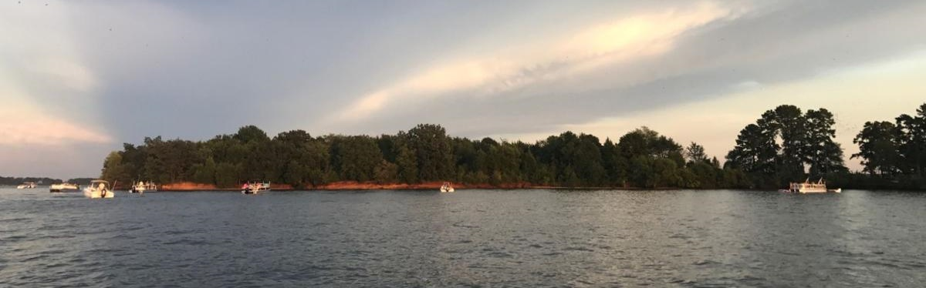
AAW Program: Cleanup Days
Groups are required to pick up litter twice each year.
Groups may choose when to pick up but are encouraged to pick up:
  Once in the spring during the ‘Great American Cleanup’ period (i.e. between the first day of spring and the first day of summer)
  Once in the fall on ‘Beach Sweep, River Sweep’ Day (i.e. the 3rd Saturday in September) which is when KMB holds the Lake Sweep Litter Sweep event
Groups are responsible for disposing of their own material collected.
Continue

Slide 9

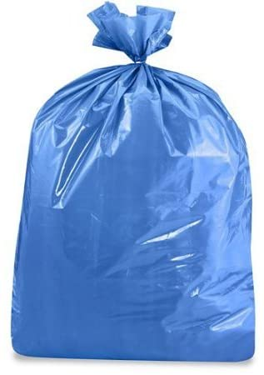
AAW Program: Recycling
Separating recyclable material from trash is not required but is strongly encouraged.
  Request blue bags for recyclables from KMB.
  Taking the recyclables to a recycling center or placing them in your curbside bin is your responsibility.
Continue

Slide 10
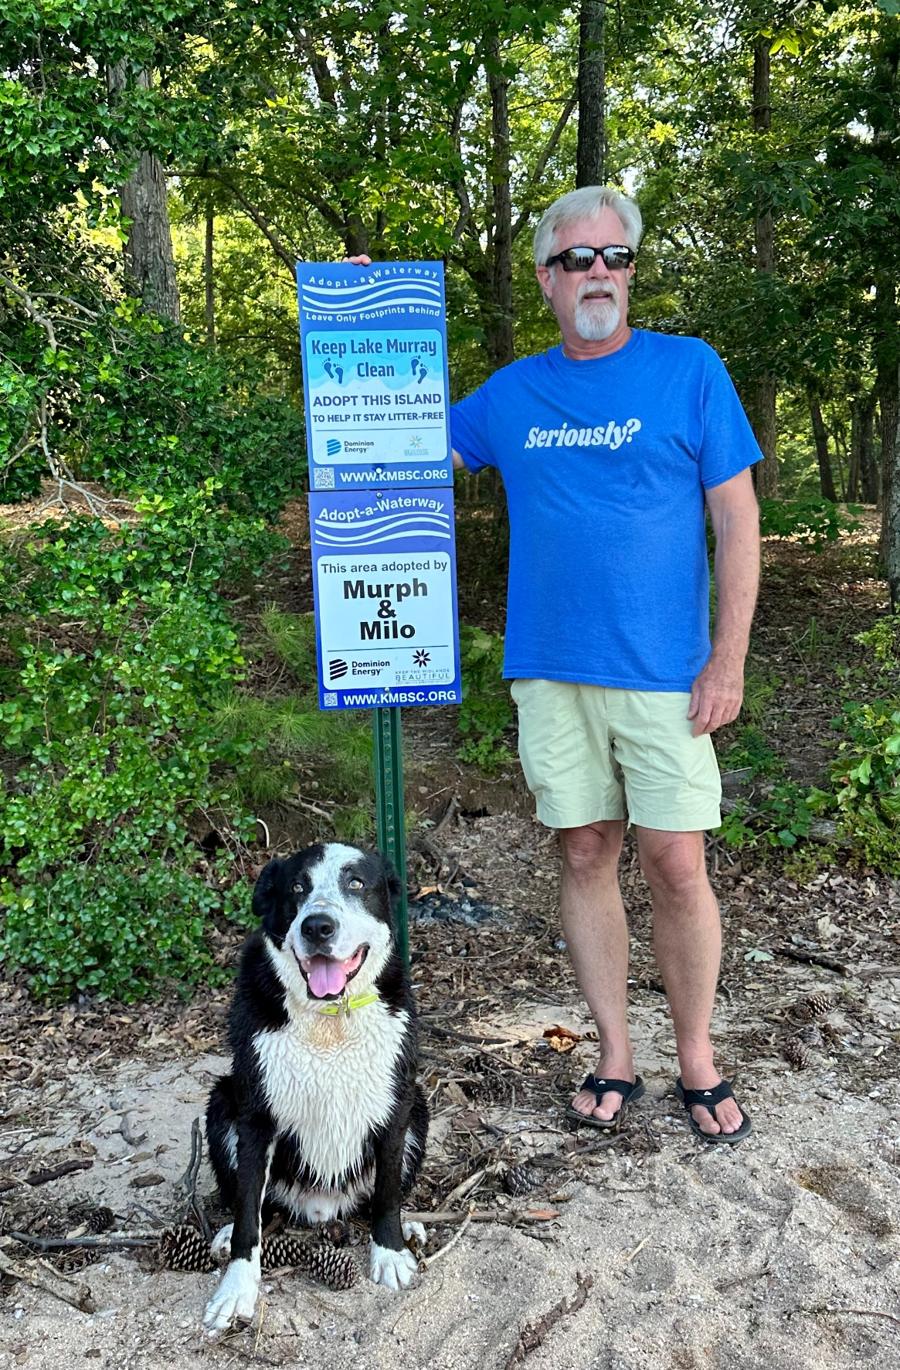
AAW Program: Recognition Sign
A sign will be provided after your first cleanup to recognize your group’s efforts.
You are responsible for putting the sign up.
Poles are in place at most locations but will be provided, along with all equipment, if needed.
Continue

Slide 11
AAW Program: Additional Information
Additional program information, event information and forms are available on the Keep the Midlands Beautiful website at:
Adopt-A-Waterway - Keep The Midlands Beautiful
Continue

Slide 12
QUIZ Question #1
How many times each year is your group required to pick up litter from your Adopt-A-Waterway location?
One
Two
Four
Click on the correct answer.

Slide 13

Correct! Congratulations!
Next Question
This Photo by Unknown Author is licensed under CC BY-SA

Slide 14
Please Try Again
Go Back to Question

Slide 15
QUIZ Question #2
Collecting recyclables separately is strongly recommended but is not required.
A) True
B) False
Click on the correct answer.

Slide 16
Correct! Congratulations!
Continue
This Photo by Unknown Author is licensed under CC BY-SA

Slide 17
Please Try Again
Go Back to Question

Slide 18
Safety & Orientation Training Topics
AAW Program
Click Here
Group Leader Responsibilities
Safety First
Cleanup Day
Policies and Procedures

Slide 19
Group Leader Responsibilities: Information Folder
It is YOUR responsibility as a Group Leader to maintain an AAW Information Folder for your group!
To obtain all important documents in the AAW Information Folder, the Group Leader can:
Pick them up from the KMB Office;
Have all contents emailed to you.
Download them from the virtual folder at any time.
Link to the
Virtual Folder:
https://rb.gy/zihwsu
Continue

Slide 20
Group Leader Responsibilities: Information Folder
Group Leader Information Folder
View each tab to see what is included in your AAW Information Folder along with its purpose. Links to each virtual document are included in the description.
Agreement Form
This form is completed for each two-year commitment period.
AAW Agreement Form Link:
Microsoft Word - 2020 AAW agreement form.docx
AAW Group Leader Checklist
Volunteer Sign-in / Hold Harmless Agreement
Safety Guidelines Sheet
Report Card
Next Tab

Slide 21
Group Leader Responsibilities: Information Folder
Group Leader Information Folder
Click on each tab to see what is included in your AAW Information Folder along with its purpose. Links to each virtual document are included in the description.
Agreement Form
AAW Group Leader Checklist
This checklist contains all items and information needed for day of AAW Cleanup
Link to checklist:
https://docs.google.com/document/d/1FM62IgolirwoZYKqdb6uQHeDeQGptCRK/edit
Volunteer Sign-in / Hold Harmless Agreement
Safety Guidelines Sheet
Report Card
Next Tab

Slide 22
Group Leader Responsibilities: Information Folder
Group Leader Information Folder
Click on each tab to see what is included in your AAW Information Folder along with its purpose. Links to each virtual document are included in the description.
Agreement Form
AAW Group Leader Checklist
Volunteer Sign-in / Hold Harmless Agreement
This sheet is for ALL group members to sign as record of participating and recognizing that KMB, Dominion Energy, Palmetto Pride, Lexington and Richland County and City of Columbia sponsors are not responsible for injuries or damages during AAW Cleanup Days.
•All volunteers under the age of 18 must have adult supervision and a guardian's signature
•All volunteers are only required to sign this one time. Only submit this form to KMB if you have a new volunteer.
Links to Volunteer Sign-in/Waiver Forms:
Groups & Families - Volunteer-Waiver-Group-Generic-Fillable.pdf
Adults – KMB Volunteer and Registration Form
Youth (<18) - KMB Volunteer and Registration Form
Safety Guidelines Sheet
Report Card
Next Tab

Slide 23
Group Leader Responsibilities: Information Folder
Group Leader Information Folder
Click on each tab to see what is included in your AAW Information Folder along with its purpose. Links to each virtual document are included in the description.
Agreement Form
AAW Group Leader Checklist
Volunteer Sign-in / Hold Harmless Agreement
Safety Guidelines Sheet
It is the Group Leader’s responsibility to conduct a safety review with the entire group before participating in EACH AAW Cleanup Day.
Link to Safety Guidelines Tip Sheet:
https://keepthemidlandsbeautiful.org/wp-content/uploads/2026/05/Safety-Sheet-Dos-and-Donts-AAW.pdf
Report Card
Next Tab

Slide 24
Group Leader Responsibilities: Information Folder
Group Leader Information Folder
Click on each tab to see what is included in your AAW Information Folder along with its purpose. Links to each virtual document are included in the description.
Agreement Form
AAW Group Leader Checklist
Volunteer Sign-in / Hold Harmless Agreement
Safety Guidelines Sheet
Report Card
The report card MUST be filled out and submitted after EACH AAW Cleanup Day! The Report Card includes group name, contact representative, email, county of cleanup, date cleaned, total hours worked, total number of volunteers, total bags of trash and total bags recycled (optional).
These may be submitted electronically using the link on KMB’s website or by providing information by phone.
Link to Blank Report Card:
Continue

Slide 25
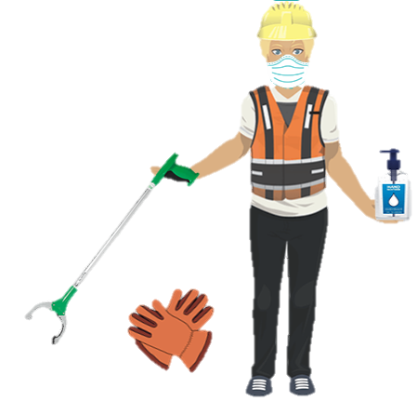
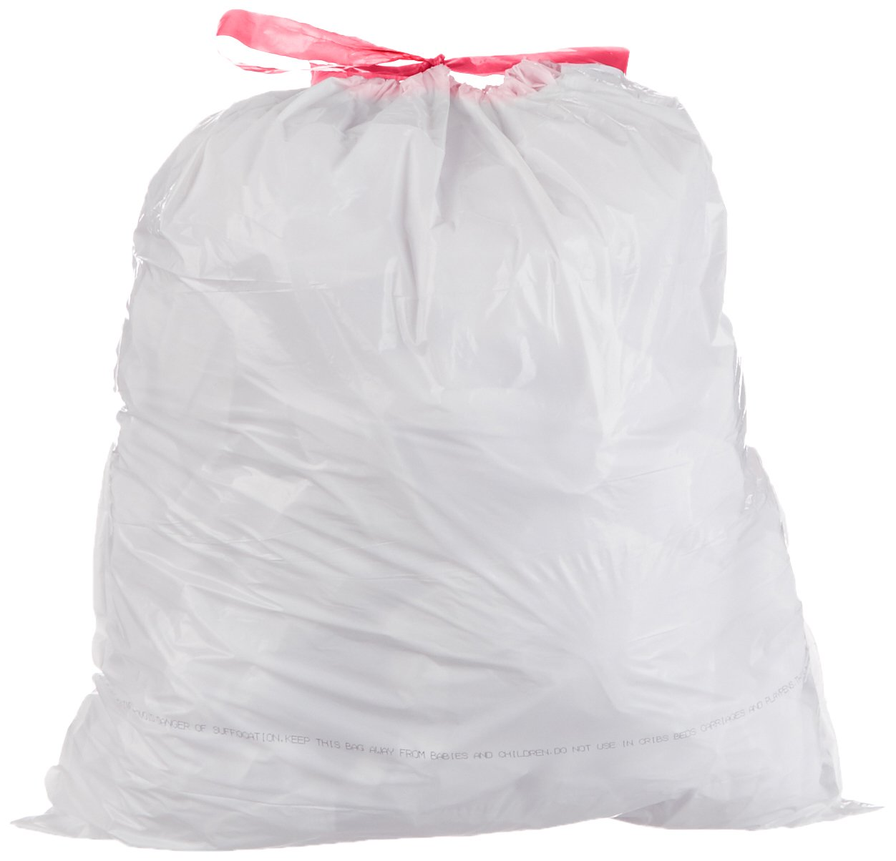
Group Leader Responsibilities: Supplies
Group Leaders are responsible for determining how many supplies will be needed for their group as well as storing leftover trash bags between each cleanup. Supplies must be requested from KMB at least 1 week prior to pick-up.
Blue recycling bags are optional, and I must return everything except disposable bags to KMB after each cleanup!
Safety Vests
Litter Grabbers
Safety Gloves
Safety Signs
White AAW Trash Bags
Blue AAW Recycling Bags
Reusable Mesh Bags, small and large
Continue

Slide 26
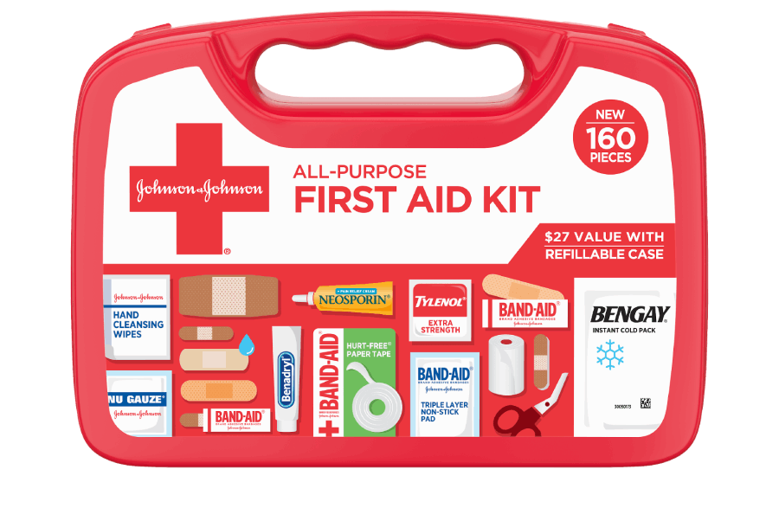
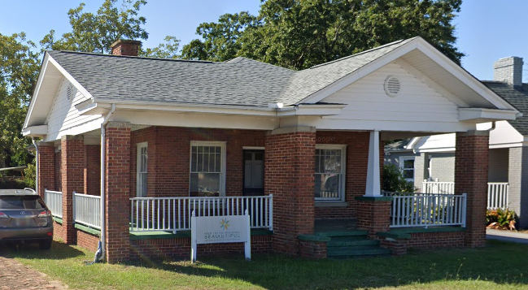
Group Leader Responsibilities: Supplies Cont.
Group Leaders can pick up supplies the week before each cleanup at the KMB office located at:
1305 Augusta Rd., West Columbia
Group Leaders are responsible for providing a First Aid Kit for their group!
Continue
Continue

Slide 27
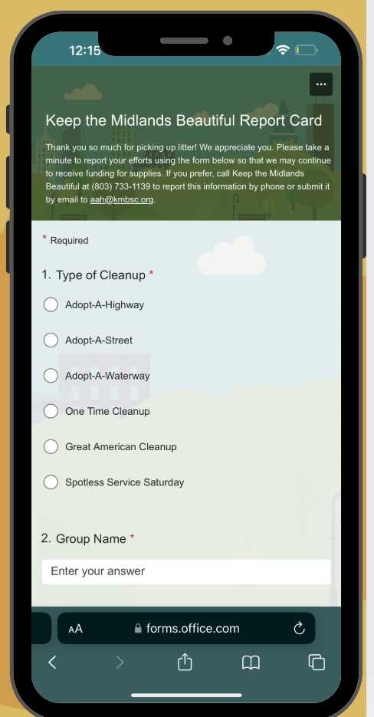
Group Leader Responsibilities: Report Card Submission
Reporting your results is very important!
It is the Group Leader’s responsibility to submit a Report Card after EACH AAW cleanup.
Reports can be submitted one of two ways:
Online: Keep The Midlands Beautiful Report Card
Phone: 803-733-1139
Reporting your group’s results tells KMB:
Which groups are active
Which waterways have been cleaned
How many volunteers are involved
How much litter has been removed
Continue

Slide 28
Group Leader Responsibilities: Report Illicit Discharges
An illicit discharge is any kind of dumping into storm drains or the storm water system (e.g. rivers) that does not consist entirely of storm water or uncontaminated groundwater.
Warning signs include suds, oil/gas sheen, sewage, unusual color or cloudiness, strong or musty odor, and flow into a storm drain three days after it has rained.
Examples include:
  Water from washing cars
  Gas and motor oil
  Kitchen grease/oil
  Household cleaners
  Paints
  Pesticides
Report illicit discharges to:
DES’s 24-hour Emergency Response Line at 803-253-6488.
Continue

Slide 29
QUIZ Question #3
Which items must the Group Leader return to KMB after each cleanup?
Trash and Recycling Bags
Litter Grabbers and Safety Vests
Hand Sanitizers and Work Gloves
Everything except Disposable Bags
Click on the correct answer.

Slide 30
Correct! Congratulations!
Next Question
This Photo by Unknown Author is licensed under CC BY-SA

Slide 31
Please Try Again
Go Back to Question

Slide 32
QUIZ Question #4
How can Group Leaders submit their Report Card after each Cleanup?
Online
In person at the KMB Office (e.g. when returning supplies)
Mail
Phone
Email
Any or all of the above
Click on the correct answer.

Slide 33
Correct! Congratulations!
Continue
This Photo by Unknown Author is licensed under CC BY-SA

Slide 34
Please Try Again
Go Back to Question

Slide 35
Safety & Orientation Training Topics
AAW Program
Group Leader Responsibilities
Safety First
Cleanup Day Policies and Procedures

Slide 36
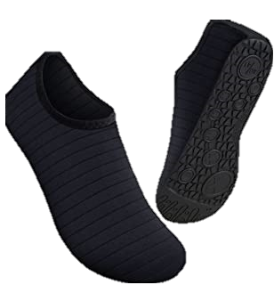
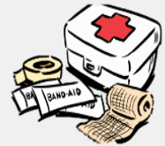









Safety First: Safety Guidelines
Continue
The Eight Safety Do’s
DO wear life jackets on boats for safety and follow all boater safety rules. Wear safety vests near vehicles.
DO look before you step, reach, or grab. Watch out for natural hazards: bees, fire ants, poisonous plants, snakes, ticks, etc.
DO dress for the weather. Long pants and closed toe water shoes are recommended.
DO have a first aid kit and cell phone on hand. Give your number to volunteers.
DO make sure every participant is healthy and physically capable of the work. Take frequent water breaks to avoid heat exhaustion.
DO look out for holes, briars, and tree trunks that could be on your route.
DO be careful when handling broken glass and kneeling in areas where glass could be hidden.
DO identify items before touching. You do not have to touch anything you do not feel comfortable with.

Slide 37
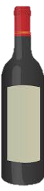



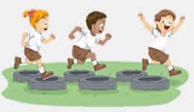





Safety First: Safety Guidelines
Continue
The Eight Safety Don’ts
DON’T bring or arrive under the influence of alcohol or illegal drugs. Doing so prohibits volunteers from participating.
DON’T handle hazardous litter: syringes, needles, car batteries, containers of chemicals, dead animals, weapons, etc.
DON’T get sunburnt. Wear sunscreen and a hat to protect your skin.
DON’T engage in horseplay!
DON’T bring knives, machetes or other such tools that could cause accidental injuries.
DON’T touch or disturb animals in their habitat. Be alert and respectful of wildlife.
DON’T compress trash in the bags as sharp objects could cause injuries. Bags should be 2/3 full.
DON’T touch a bucket used as a privy or toilets at camp sites!

Slide 38
QUIZ Question #5
All participants should be healthy and take frequent water breaks.
True
False
Click on the correct answer.

Slide 39
Correct! Congratulations!
Continue
This Photo by Unknown Author is licensed under CC BY-SA

Slide 40
Please Try Again
Go Back to Question

Slide 41

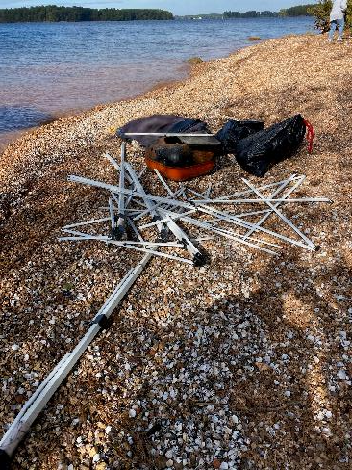
Safety First: Safety Reporting
Reporting Injuries
If a participant becomes injured at any time during a cleanup, the Group Leader must report the injury on the “Injury Report Form” located in your Information Folder.
Reporting Hazards
Any dump sites or hazardous items found including medical waste, dead animals, tires, furniture or others must be noted with the item(s) and location to Keep the Midlands Beautiful following a cleanup. If the item is immediately dangerous, contact law enforcement.
Don’t forget!
Group Leaders must submit a Cleanup Report Card immediately following each cleanup.
Continue

Slide 42
QUIZ Question #6
A group member receives a minor injury while picking up trash. What should the Group Leader do in this case?
Report the injury on the “Injury Report Form.”
Call 911.
Do nothing.
Click on the correct answer.

Slide 43
Correct! Congratulations!
Continue
This Photo by Unknown Author is licensed under CC BY-SA

Slide 44
Please Try Again
Go Back to Question

Slide 45
Safety & Orientation Training Topics
AAW Program
Group Leader Responsibilities
Safety First
Cleanup Day Policies and Procedures
Continue

Slide 46
Cleanup Day Policies & Procedures: Upon Arrival
Arriving on Cleanup Day
It is finally the big and exciting day; cleanup day! Click each tab to review what you as a Group Leader must do upon arrival to ensure a fun and safe cleanup!
Start Time
Dress
Parking
Sign-in & Safety Meet
Litter Pick Up Sign
Your group may start anytime after sunrise but must finish before dark.

Slide 47
Cleanup Day Policies & Procedures: Upon Arrival
Arriving on Cleanup Day
It is finally the big and exciting day; cleanup day! Click each tab to review what you as a Group Leader must do upon arrival to ensure a fun and safe cleanup!
Start Time
Dress
Parking
Sign-in & Safety Meet
Litter Pick Up Sign
Remind all group members to dress for the weather but to preferably wear long pants and closed toe water shoes for safety.

Slide 48
Cleanup Day Policies & Procedures: Upon Arrival
Arriving on Cleanup Day
It is finally the big and exciting day; cleanup day! Click each tab to review what you as a Group Leader must do upon arrival to ensure a fun and safe cleanup!
Start Time
Dress
Parking
Sign-in & Safety Meet
Litter Pick Up Sign
Cars should be parked in a predetermined location, preferably in a parking lot.
Group Leaders will need to ask permission to park in a private parking lot.
Cars should NOT be parked in medians or on sidewalks and must never block driveways.

Slide 49
Cleanup Day Policies & Procedures: Upon Arrival
Arriving on Cleanup Day
It is finally the big and exciting day; cleanup day! Click each tab to review what you as a Group Leader must do upon arrival to ensure a fun and safe cleanup!
Start Time
Dress
Parking
Sign-in & Safety Meet
Litter Pick Up Sign
Group Leaders sign in and submit only NEW participating members on the “Volunteer Sign-in/Hold Harmless” form in your Information Folder.
Any volunteer younger than 18 must have a legal guardian signature and be supervised by an adult at all times!
Remember to conduct a meeting with all group members before EACH cleanup to review all safety guidelines.

Slide 50

Cleanup Day Policies & Procedures: Upon Arrival
Arriving on Cleanup Day
It is finally the big and exciting day; cleanup day! Click each tab to review what you as a Group Leader must do upon arrival to ensure a fun and safe cleanup!
Start Time
Dress
Parking
Sign-in & Safety Meet
Litter Pick Up Sign
Before beginning, put out “Volunteers Picking Up Litter” signs if appropriate for your location. These may be borrowed from Keep the Midlands Beautiful.
Continue

Slide 51
Cleanup Day Policies & Procedures: Finishing Up
Leaving on Cleanup Day
Click on each tab to review what you as a Group Leader must do upon leaving to ensure a fun and safe cleanup!
Bagged Trash
Recycling
Litter Pick Up Sign
Submit Report Card
Do not compress trash
Tie bags tightly
Report the location and type of any items too large or heavy to move and dispose of yourself to KMB
Count and report the number of bags and other debris collected
Properly dispose of all trash you collect (in your curbside bin, at the landfill or at a County Collection and Recycling Center)

Slide 52
Cleanup Day Policies & Procedures: Finishing Up
Leaving on Cleanup Day
Click on each tab to review what you as a Group Leader must do upon leaving to ensure a fun and safe cleanup!
Bagged Trash
Recycling
Litter Pick Up Sign
Submit Report Card
If your group chooses to recycle:
•Obtain blue recycle bags from KMB prior to cleanup (call ahead before pickup);
•Separate recyclable material from trash;
•Place recyclables in your curbside bin or take to a County Collection and Recycling Center.

Slide 53
Cleanup Day Policies & Procedures: Finishing Up
Leaving on Cleanup Day
Click on each tab to review what you as a Group Leader must do upon leaving to ensure a fun and safe cleanup!
Bagged Trash
Recycling
Litter Pick Up Sign
Submit Report Card
At the end of the cleanup, remove any temporary “Volunteers Picking Up Litter” signs that you put out.

Slide 54
Cleanup Day Policies & Procedures: Finishing Up
Leaving on Cleanup Day
Click on each tab to review what you as a Group Leader must do upon leaving to ensure a fun and safe cleanup!
Bagged Trash
Recycling
Litter Pick Up Sign
Submit Report Card
It is your responsibility as a Group Leader to complete a “Report Card” after each cleanup and to submit it to Keep the Midlands Beautiful:
Online - preferred
In person
By phone or
By email
Continue

Slide 55
QUIZ Question #7
Where should group members park their cars when arriving at their cleanup location?
A predetermined location
Anywhere they can
Preferably a parking lot (that the Group Leader has obtained permission to use if needed)
Both A and C
Click on the correct answer.

Slide 56
Correct! Congratulations!
Continue
This Photo by Unknown Author is licensed under CC BY-SA

Slide 57
Please Try Again
Go Back to Question

Slide 58
QUIZ Question #8
Volunteers are encouraged to wear long pants and closed toe water shoes for safety reasons.
True
False
Click on the correct answer.

Slide 59
Correct! Congratulations!
Continue
This Photo by Unknown Author is licensed under CC BY-SA

Slide 60
Please Try Again
Go Back to Question

Slide 61
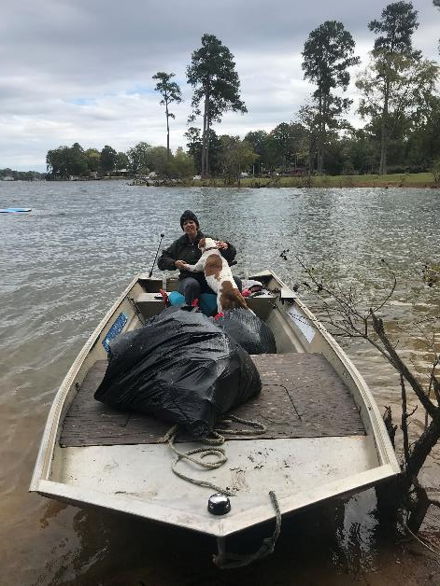
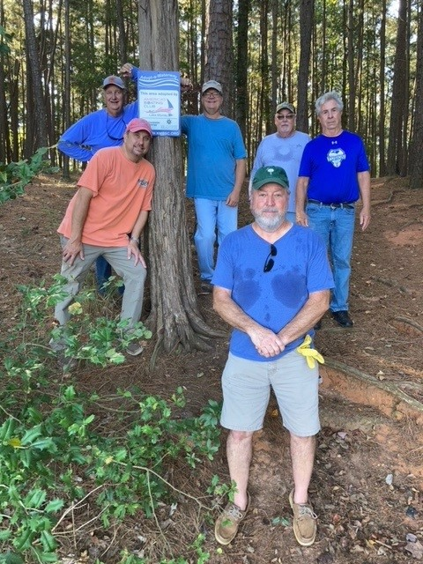
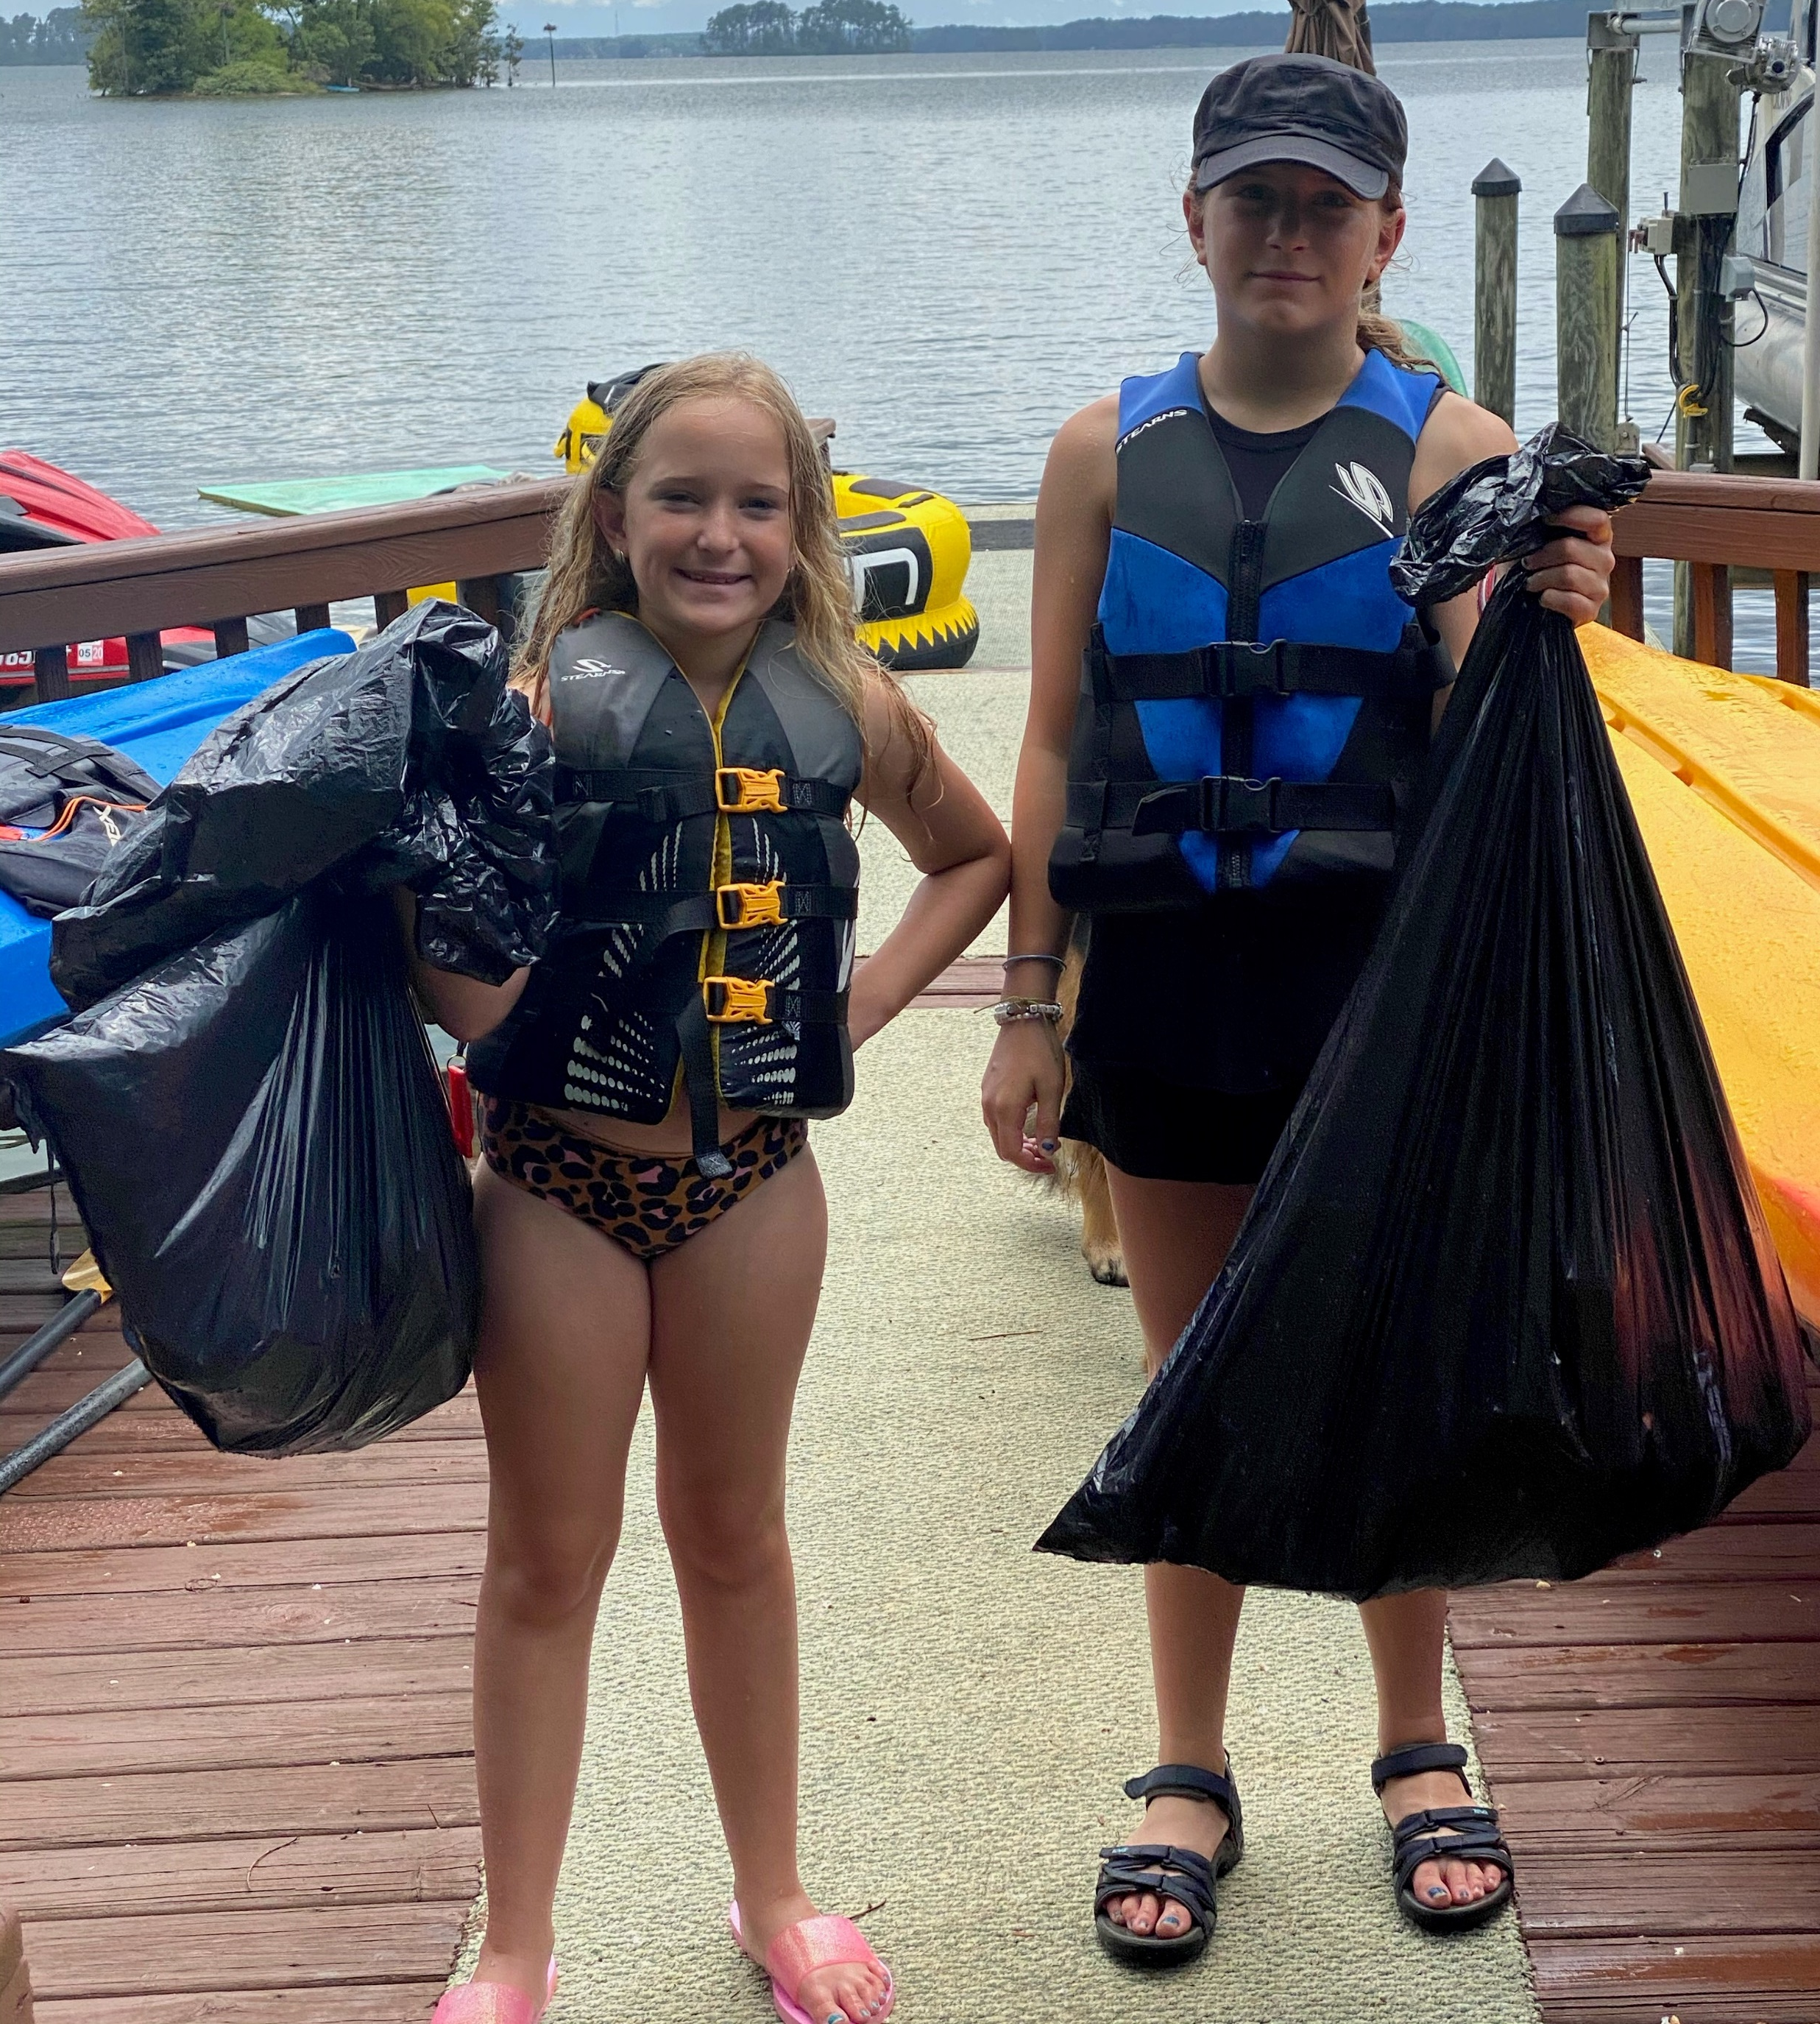
Be creative and have fun!
Continue
Send before and after photos to programs@kmbsc.org

Slide 62
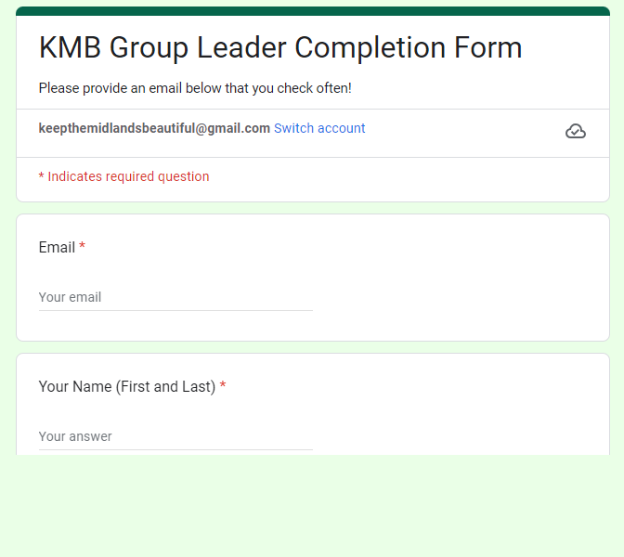

To get credit for completing this course- complete this short form https://forms.gle/aF3XUWzqEgs9KsGv9
Continue

Slide 63
Thank you for volunteering
and for completing this Adopt-A-Waterway safety and orientation course for Group Leaders!
The End

