Slide 1
Mandatory Orientation and Safety Training for New
Adopt-A-Highway & Adopt-A-Street
Group Leaders
Continue

Slide 2

Introduction
In the Adopt-A-Highway and Adopt-A-Street programs, your group is an important part of an overall community-based plan to:
Reduce litter by helping to keep state-maintained roads clean
Raise public awareness about the costly and unsightly problem of litter.
“There are more than 50 billion pieces of litter along our nation’s roadways with 4.6 billion pieces larger than 4 inches!”
- Keep America Beautiful
Continue

Slide 3
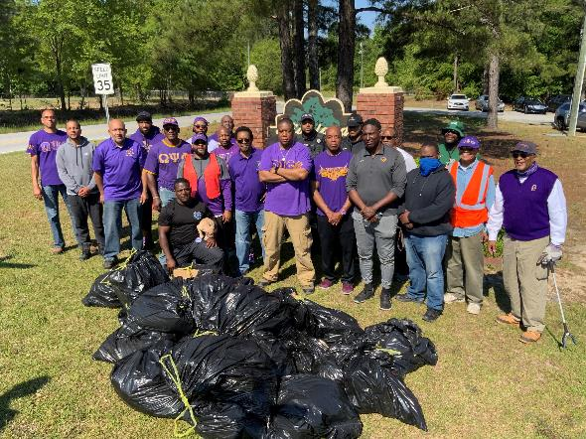
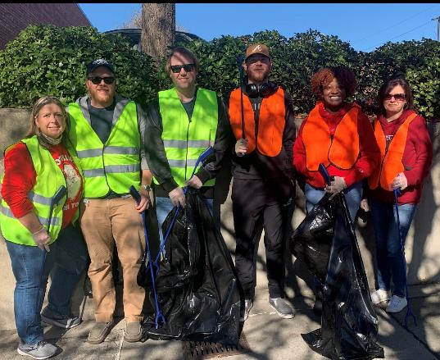
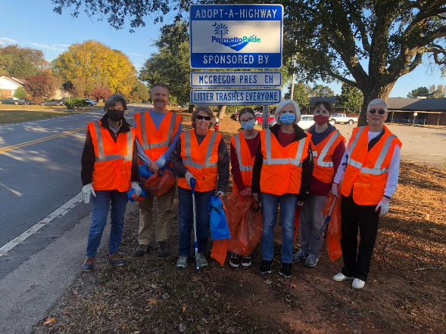
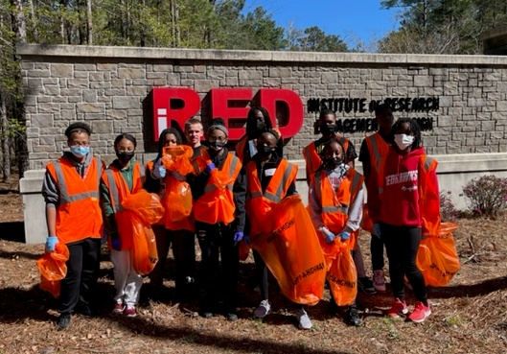
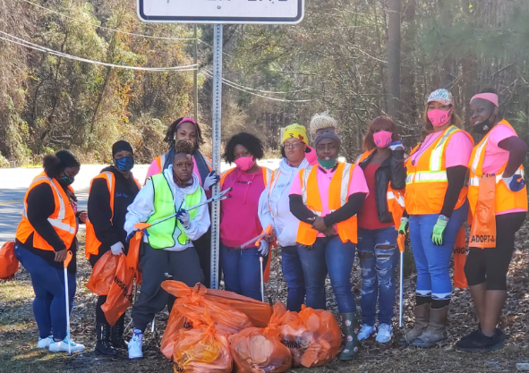
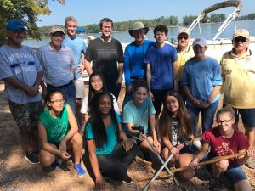
In 2024, 6,500 volunteers from 310 groups in Lexington County, Richland county and the City of Columbia helped Keep the Midlands Beautiful by removing XXX,XXX pounds of litter.
Continue

Slide 4






Our Mission and Partners
The mission of Keep the Midlands Beautiful is to engage, inspire, and educate the Midlands to invest in our community through litter prevention, recycling, and beautification.
KMB is a 501 (c) (3) organization supported by:
Adopt-A-Highway, Adopt-A-Street and Adopt-A-Waterway Partners:
Continue

Slide 5
Learning Objectives
By the end of this training, you will be able to:
Identify Group Leader responsibilities that occur prior to, during, and after group cleanups
Facilitate a safe group cleanup day by applying AAW safety policies and procedures.
and
Continue

Slide 6
Safety & Orientation Training Topics
AAH/AAS Programs
Group Leader Responsibilities
Safety First
Cleanup Day
Policies and Procedures

Slide 7
Adopt-A Programs: Your Commitment
Agreement Form
Keep a copy of your signed agreement form at all times.
Link to AAH Agreement Form
Link to AAS AgreementForm
Program Commitment
This program is a two-year commitment.
At the end of your two-year commitment period, if you choose to renew, you are required to complete a new agreement form.
Reporting Requirements
You are required to submit a report card after each cleanup.
Failure to report two consecutive cleanups results in a breach of agreement and your group could be dropped from the program.
Link to Report Card
Continue

Slide 8
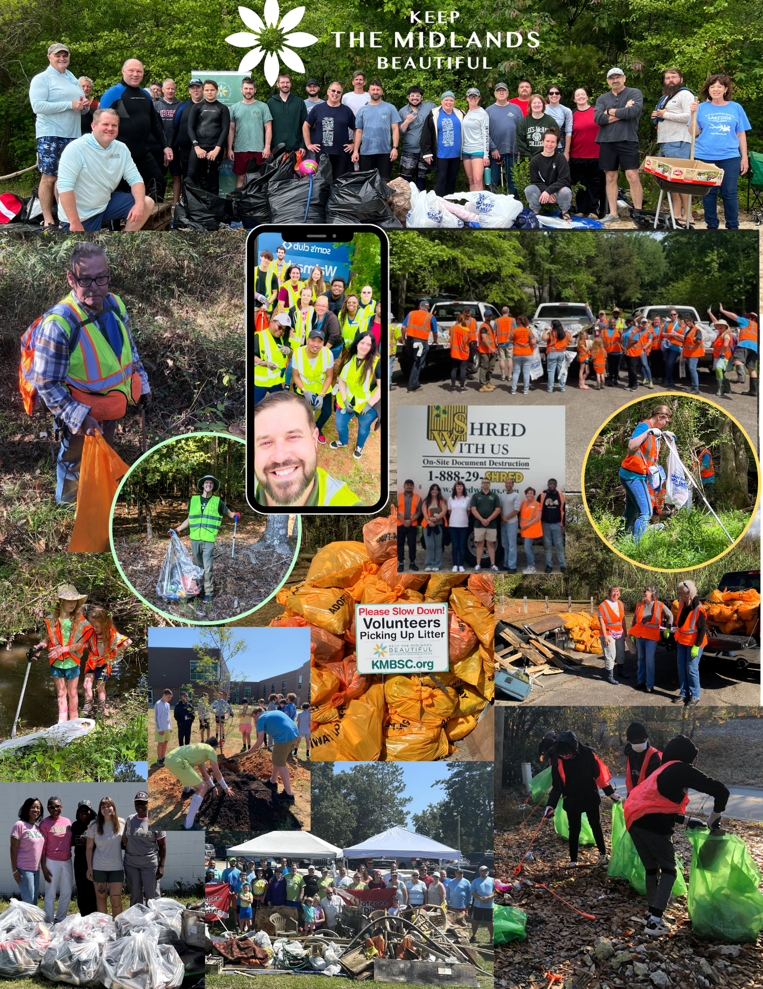
Adopt-A Programs: Cleanup Days
Groups are required to pick up litter four times each year.
Groups may choose when to pick up but are encouraged to pick up:
  During quarterly cleanups on the preselected dates that KMB and SCDOT have chosen. The dates for 2025 and 2026 are below;
    Saturday, February 8, 2025, Saturday, May 17, 2025, Saturday, August 16, 2025, Saturday, November 15, 2025
    Saturday, February 14, 2026, Saturday, May 16, 2026, Saturday, August 15, 2026, Saturday, November 21, 2026
Groups that clean on dates not listed above are responsible for disposing of their own trash and recycling
Inclement Weather
In case of Heavy Rain or Thunderstorms on cleanup days, the cleanup will be rescheduled for the following Saturday and bags will be picked up as usual
Continue

Slide 9

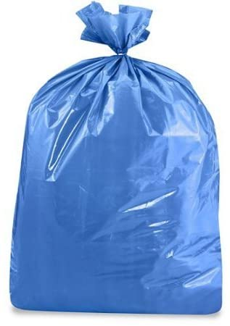
Adopt-A Programs: Recycling
Separating recyclable material from trash is not required but is strongly encouraged.
  Request blue bags for recyclables from KMB.
  Taking the recyclables to a recycling center or placing them in your curbside bin is your responsibility.
Continue

Slide 10
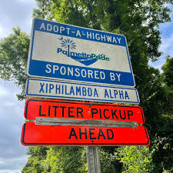
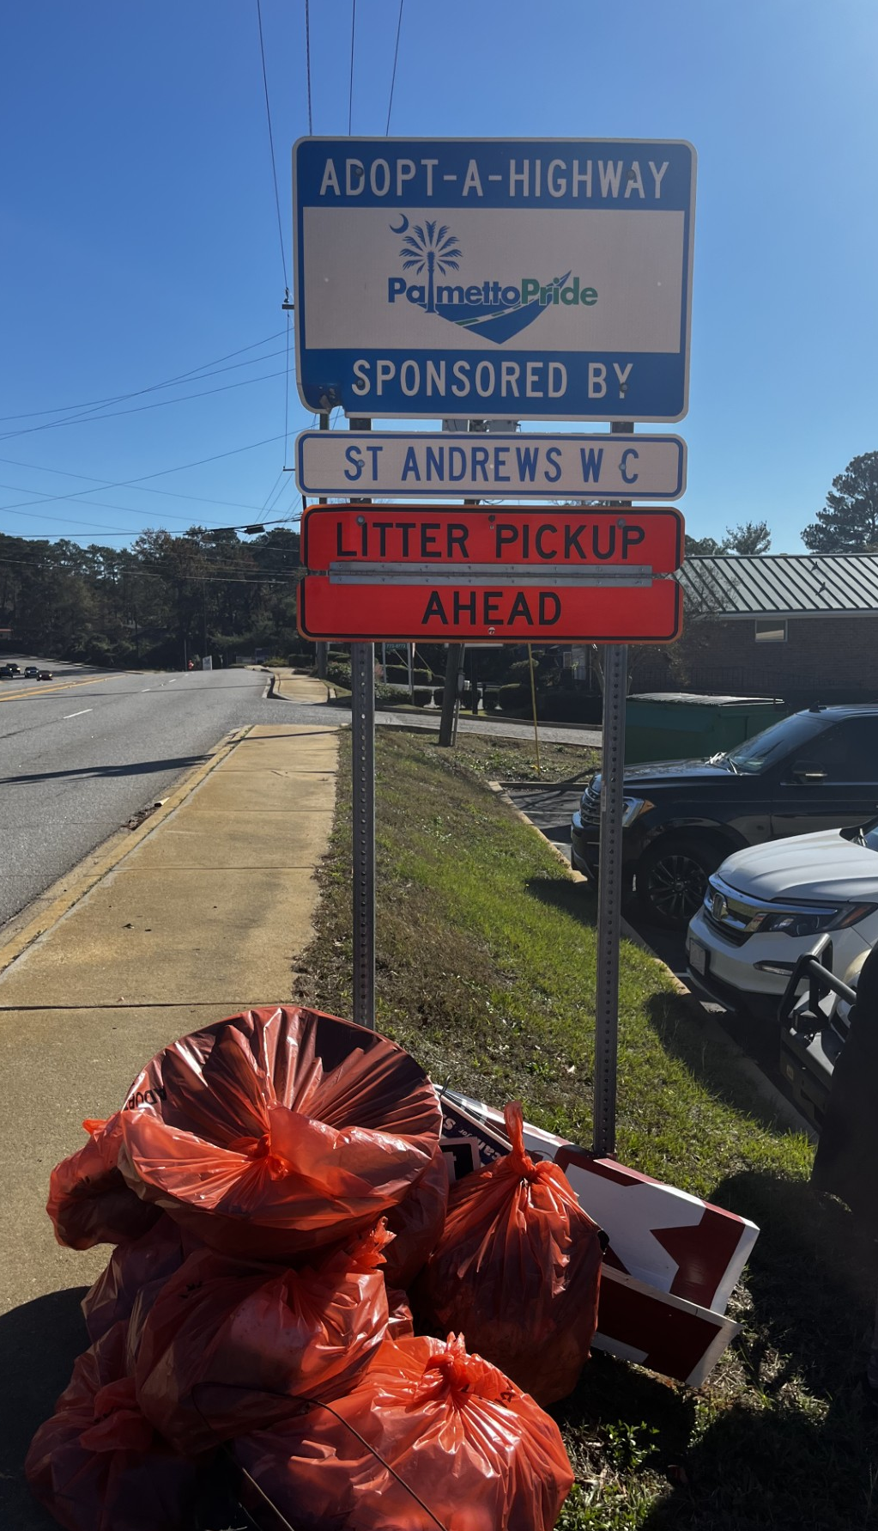
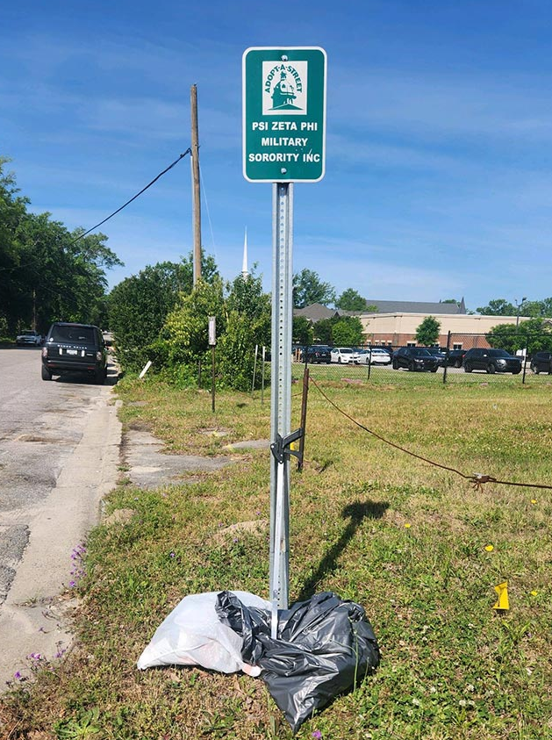
Adopt-A Programs: Recognition Sign
A sign will be provided after your first two cleanups to recognize your group’s efforts.
The sign will be installed by the City of Columbia or SCDOT.
Continue

Slide 11
Adopt-A Programs: Additional Information
Additional program information, event information and forms are available on the Keep the Midlands Beautiful website at:
https://keepthemidlandsbeautiful.org/what-we-do/nonprofit2019/about-aah/
https://keepthemidlandsbeautiful.org/what-we-do/nonprofit2019/city-of-columbia-aah/
Continue

Slide 12
QUIZ Question #1
How many times each year is your group required to pick up litter from your Adopt-A-Highway or Adopt-A-Street location?
One
Four
Two
Click on the correct answer.

Slide 13

Correct! Congratulations!
Next Question
This Photo by Unknown Author is licensed under CC BY-SA

Slide 14

Please Try Again
Go Back to Question

Slide 15
QUIZ Question #2
Collecting recyclables separately is strongly recommended but is not required.
A) True
B) False
Click on the correct answer.

Slide 16
Correct! Congratulations!
Continue
This Photo by Unknown Author is licensed under CC BY-SA

Slide 17
Please Try Again
Go Back to Question

Slide 18
Safety & Orientation Training Topics
AAH/AAS Program
Group Leader Responsibilities
Safety First
Cleanup Day
Policies and Procedures

Slide 19
Group Leader Responsibilities: Information Folder
It is YOUR responsibility as a Group Leader to maintain an AAH/AAS Information Folder for your group!
To obtain all important documents in the AAW Information Folder, the Group Leader can:
Pick them up from the KMB Office
Have all contents emailed to you
Download them from the virtual folder at any time
Link to the
Virtual Folder:
https://rb.gy/zihwsu
Continue

Slide 20
Group Leader Responsibilities: Information Folder
Group Leader Information Folder
View each tab to see what is included in your AAH/AAS Information Folder along with its purpose. Links to each virtual document are included in the description.
Agreement Form
This form is completed for each two-year commitment period.
AAW Agreement Form Link:
https://kmbsc.wpengine.com/wp-content/uploads/2020/03/2020-AAW-agreement-form.pdf
AAW Group Leader Checklist
Volunteer Sign-in / Hold Harmless Agreement
Safety Guidelines Sheet
Report Card
Next Tab

Slide 21
Group Leader Responsibilities: Information Folder
Group Leader Information Folder
View each tab to see what is included in your AAH/AAS Information Folder along with its purpose. Links to each virtual document are included in the description.
Agreement Form
AAW Group Leader Checklist
This checklist contains all items and information needed for day of AAW Cleanup
Link to checklist:
https://docs.google.com/document/d/1FM62IgolirwoZYKqdb6uQHeDeQGptCRK/edit
Volunteer Sign-in / Hold Harmless Agreement
Safety Guidelines Sheet
Report Card
Next Tab

Slide 22
Group Leader Responsibilities: Information Folder
Group Leader Information Folder
Click on each tab to see what is included in your AAW Information Folder along with its purpose. Links to each virtual document are included in the description.
Agreement Form
AAW Group Leader Checklist
Volunteer Sign-in / Hold Harmless Agreement
This sheet is for ALL group members to sign as record of participating and recognizing that KMB, Dominion Energy, Palmetto Pride, Lexington and Richland County and City of Columbia sponsors are not responsible for injuries or damages during AAW Cleanup Days.
•All volunteers under the age of 18 must have adult supervision and a guardian's signature
•All volunteers are only required to sign this one time. Only submit this form to KMB if you have a new volunteer.
Links to Volunteer Sign-in/Waiver Forms:
Adults – https://keepthemidlandsbeautiful.org/wp-content/uploads/2019/03/AAW-KMB-Adult-Volunteer-Waiver.pdf
Youth (<18) - https://keepthemidlandsbeautiful.org/wp-content/uploads/2019/03/AAW-Youth-Volunteer-Waiver.pdf
Safety Guidelines Sheet
Report Card
Next Tab

Slide 23
Group Leader Responsibilities: Information Folder
Group Leader Information Folder
View each tab to see what is included in your AAH/AAS Information Folder along with its purpose. Links to each virtual document are included in the description.
Agreement Form
AAW Group Leader Checklist
Volunteer Sign-in / Hold Harmless Agreement
Safety Guidelines Sheet
It is the Group Leader’s responsibility to conduct a safety review with the entire group before participating in EACH AAW Cleanup Day.
Link to Safety Guidelines Tip Sheet:
https://keepthemidlandsbeautiful.org/wp-content/uploads/2022/06/AAW-Safety-Sheet-Dos-and-Donts.pdf
Report Card
Next Tab

Slide 24
Group Leader Responsibilities: Information Folder
Group Leader Information Folder
View each tab to see what is included in your AAH/AAS Information Folder along with its purpose. Links to each virtual document are included in the description.
Agreement Form
AAW Group Leader Checklist
Volunteer Sign-in / Hold Harmless Agreement
Safety Guidelines Sheet
Report Card
The report card MUST be filled out and submitted after EACH AAW Cleanup Day! The Report Card includes group name, contact representative, email, county of cleanup, date cleaned, total hours worked, total number of volunteers, total bags of trash and total bags recycled (optional).
These may be submitted electronically using the link on KMB’s website or by providing information by phone.
Link to Blank Report Card:
Continue

Slide 25
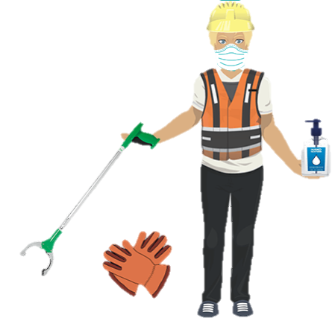
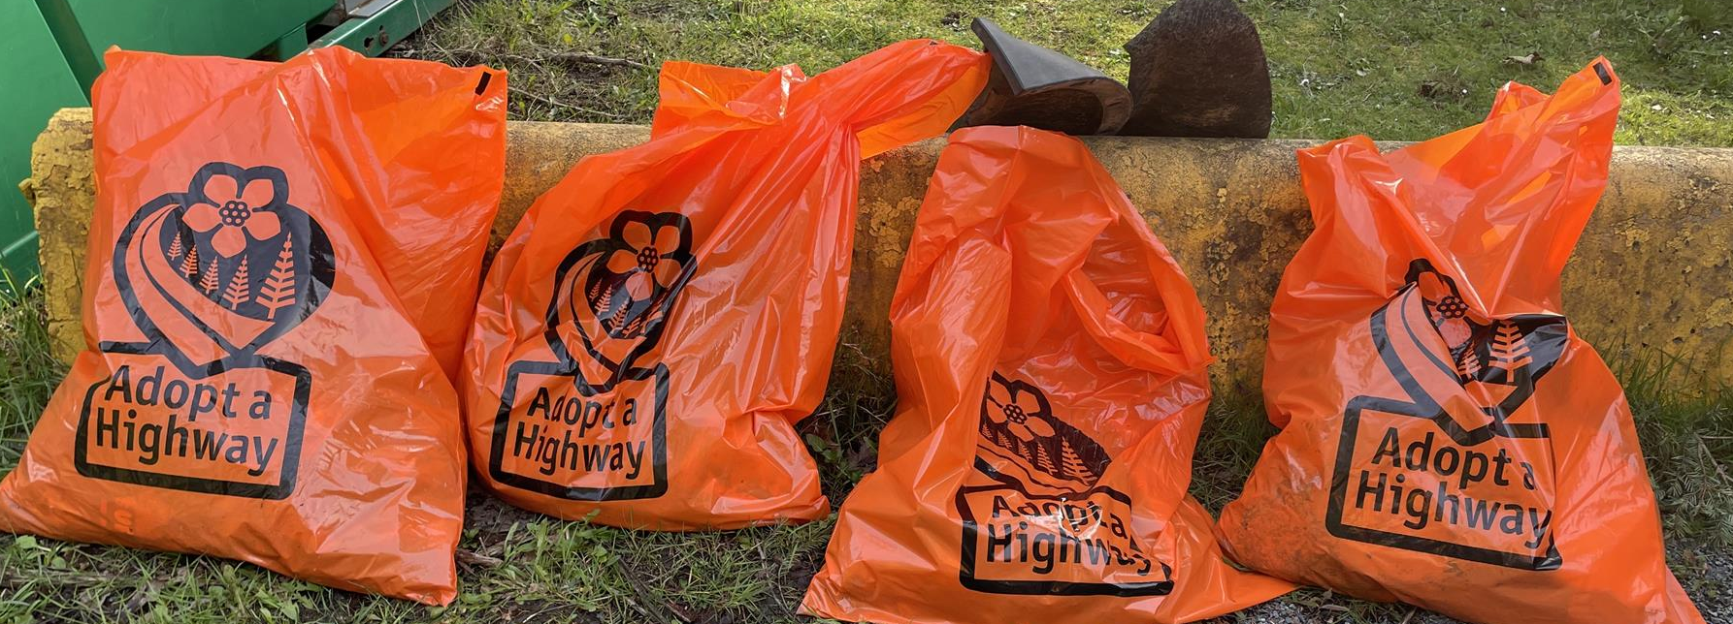
Group Leader Responsibilities: Supplies
Group Leaders are responsible for determining how many supplies will be needed for their group as well as storing leftover trash bags between each cleanup. Supplies must be requested from KMB at least 1 week prior to pick-up.
Safety Vests
Litter Grabbers
Safety Gloves
Safety Signs
Orange AAH/AAS Trash Bags
Blue Recycling Bags
Blue recycling bags are optional, and I must return everything except disposable bags to KMB after each cleanup!
Continue

Slide 26
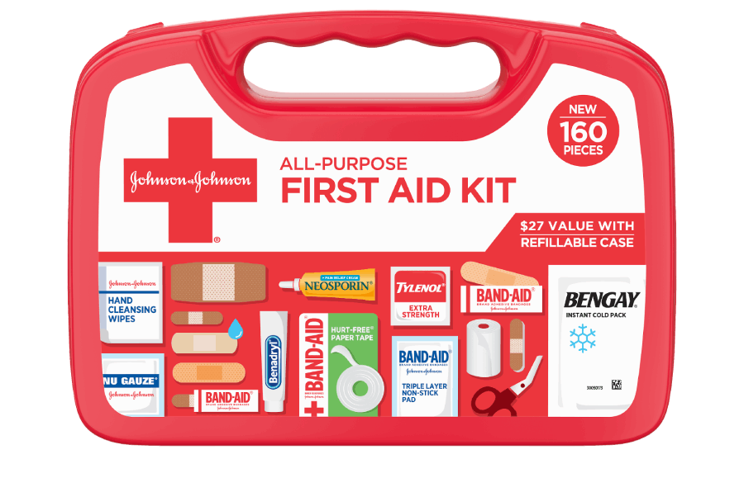
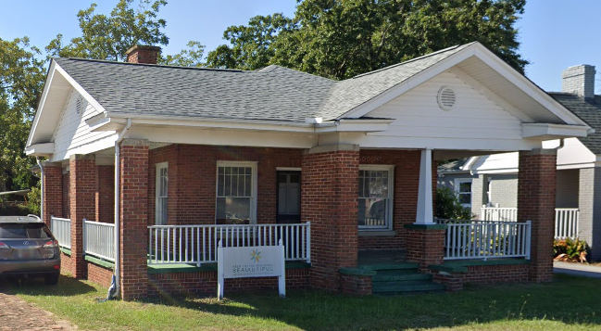
Group Leader Responsibilities: Supplies Cont.
Group Leaders can pick up supplies the week before each cleanup at the KMB office located at:
1305 Augusta Road, West Columbia
Group Leaders are responsible for providing a First Aid Kit for their group!
Continue
Continue

Slide 27
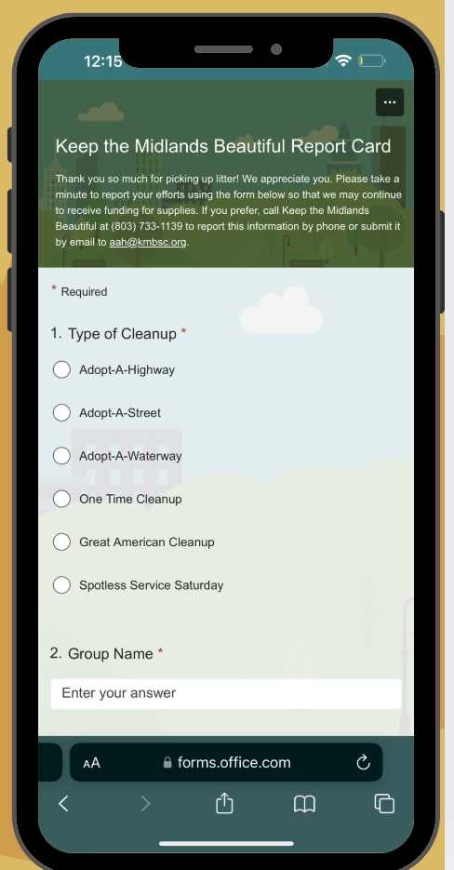
Group Leader Responsibilities: Report Card Submission
Reporting your results is very important!
It is the Group Leader’s responsibility to submit a Report Card after EACH AAW cleanup.
Reports can be submitted one of two ways:
Online: Keep The Midlands Beautiful Report Card
Phone: 803-733-1139
Reporting your group’s results tells KMB:
Which groups are active
Which roads have been cleaned
How many volunteers are involved
How much litter has been removed
Continue

Slide 28
QUIZ Question #3
Which items must the Group Leader return to KMB after each cleanup?
Trash and Recycling Bags
Litter Grabbers and Safety Vests
Hand Sanitizers and Safety Gloves
Everything except Disposable Bags
Click on the correct answer.

Slide 29
Correct! Congratulations!
Next Question
This Photo by Unknown Author is licensed under CC BY-SA

Slide 30
Please Try Again
Go Back to Question

Slide 31
QUIZ Question #4
How can Group Leaders submit their Report Card after each Cleanup?
Online
In person at the KMB Office (e.g. when returning supplies)
Mail
Phone
Email
Any or all of the above
Click on the correct answer.

Slide 32
Correct! Congratulations!
Continue
This Photo by Unknown Author is licensed under CC BY-SA

Slide 33
Please Try Again
Go Back to Question

Slide 34
Safety & Orientation Training Topics
AAW Program
Group Leader Responsibilities
Safety First
Cleanup Day Policies and Procedures

Slide 35










Safety First: Safety Guidelines
Continue
The Eight Safety Do’s
DO wear orange safety vests at ALL times
DO look before you step, reach, or grab. Watch out for natural hazards: bees, fire ants, poisonous plants, snakes, ticks, etc.
DO dress for the weather. Long pants and closed toe shoes are recommended.
DO have a first aid kit and cell phone on hand. Give your number to volunteers.
DO make sure every participant is healthy and physically capable of the work. Take frequent water breaks to avoid heat exhaustion.
DO work in pairs and face oncoming traffic. Work one side of the highway at a time.
DO be careful when handling broken glass and kneeling in areas where glass could be hidden.
DO identify items before touching. You do not have to touch anything you do not feel comfortable with.

Slide 36
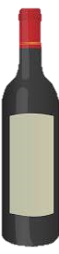



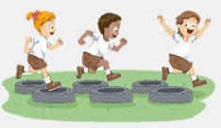
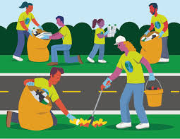




Safety First: Safety Guidelines
Continue
The Eight Safety Don’ts
DON’T bring or arrive under the influence of alcohol or illegal drugs. Doing so prohibits volunteers from participating.
DON’T handle hazardous litter: syringes, needles, car batteries, containers of chemicals, dead animals, weapons, etc.
DON’T wear hats that could obscure your vision from seeing approaching hazards
DON’T engage in horseplay!
DON’T stand on the pavement. Be alert of traffic. Remain at least 5 feet away from the road's edge
DON’T bring knives, machetes or other such tools that could cause accidental injuries.
DON’T touch or disturb animals in their habitat. Be alert and respectful of wildlife.
DON’T compress trash in the bags as sharp objects could cause injuries. Bags should be 2/3 full.

Slide 37
QUIZ Question #5
All participants should be healthy and take frequent water breaks.
True
False
Click on the correct answer.

Slide 38
Correct! Congratulations!
Continue
This Photo by Unknown Author is licensed under CC BY-SA

Slide 39
Please Try Again
Go Back to Question

Slide 40
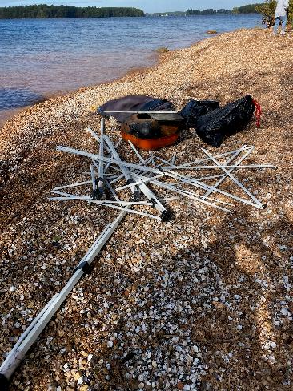
Safety First: Safety Reporting
Reporting Injuries
If a participant becomes injured at any time during a cleanup, the Group Leader must report the injury on the “Injury Report Form” located in your Information Folder.
Reporting Hazards
Any dump sites or hazardous items found including medical waste, dead animals, tires, furniture or others must be noted with the item(s) and location to
Keep the Midlands Beautiful following a cleanup. If the item is immediately dangerous, contact law enforcement.
Don’t forget!
Group Leaders must submit a Cleanup Report Card immediately following each cleanup.
Continue

Slide 41
QUIZ Question #6
A group member receives a minor injury while picking up trash. What should the Group Leader do in this case?
Report the injury on the “Injury Report Form.”
Call 911.
Do nothing.
Click on the correct answer.

Slide 42
Correct! Congratulations!
Continue
This Photo by Unknown Author is licensed under CC BY-SA

Slide 43
Please Try Again
Go Back to Question

Slide 44
Safety & Orientation Training Topics
AAW Program
Group Leader Responsibilities
Safety First
Cleanup Day Policies and Procedures
Continue

Slide 45
Cleanup Day Policies & Procedures: Upon Arrival
Arriving on Cleanup Day
It is finally the big and exciting day; cleanup day! Click each tab to review what you as a Group Leader must do upon arrival to ensure a fun and safe cleanup!
Start Time
Dress
Parking
Sign-in & Safety Meet
Litter Pick Up Sign
Your group may start any time after sunrise but must finish before dark.

Slide 46
Cleanup Day Policies & Procedures: Upon Arrival
Arriving on Cleanup Day
It is finally the big and exciting day; cleanup day! Click each tab to review what you as a Group Leader must do upon arrival to ensure a fun and safe cleanup!
Start Time
Dress
Parking
Sign-in & Safety Meet
Litter Pick Up Sign
Remind all group members to dress for the weather but to preferably wear long pants and closed toe water shoes for safety.

Slide 47
Cleanup Day Policies & Procedures: Upon Arrival
Arriving on Cleanup Day
It is finally the big and exciting day; cleanup day! Click each tab to review what you as a Group Leader must do upon arrival to ensure a fun and safe cleanup!
Start Time
Dress
Parking
Sign-in & Safety Meet
Litter Pick Up Sign
Cars should be parked in a predetermined location, preferably in a parking lot.
Group Leaders will need to ask permission to park in a private parking lot.
Cars should NOT be parked in medians or on sidewalks and must never block driveways.

Slide 48
Cleanup Day Policies & Procedures: Upon Arrival
Arriving on Cleanup Day
It is finally the big and exciting day; cleanup day! Click each tab to review what you as a Group Leader must do upon arrival to ensure a fun and safe cleanup!
Start Time
Dress
Parking
Sign-in & Safety Meet
Litter Pick Up Sign
Group Leaders sign in and submit only NEW participating members on the “Volunteer Sign-in/Hold Harmless” form in your Information Folder.
Any volunteer younger than 18 must have a legal guardian signature and be supervised by an adult at all times!
Remember to conduct a meeting with all group members before EACH cleanup to review all safety guidelines.

Slide 49
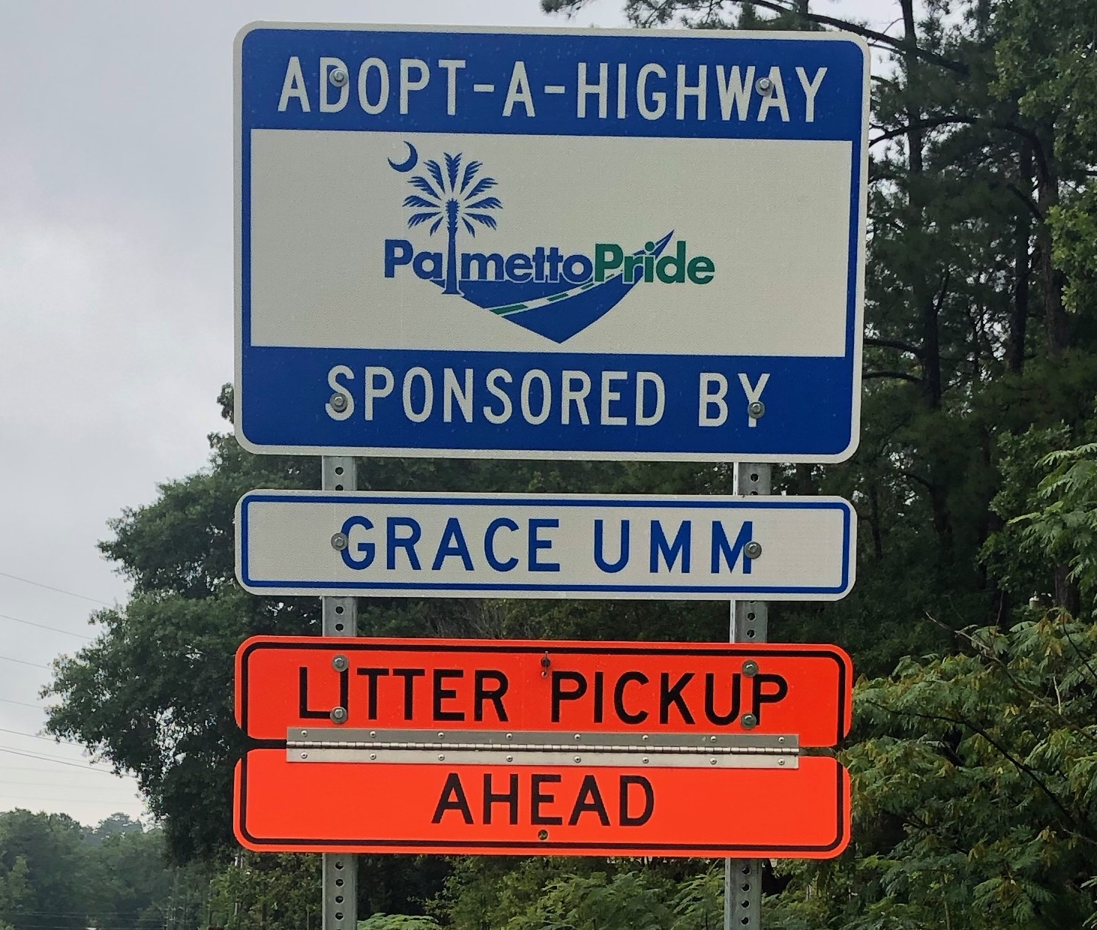

Cleanup Day Policies & Procedures: Upon Arrival
Arriving on Cleanup Day
It is finally the big and exciting day; cleanup day! Click each tab to review what you as a Group Leader must do upon arrival to ensure a fun and safe cleanup!
Start Time
Dress
Parking
Sign-in & Safety Meet
Litter Pick Up Sign
Before beginning, unfasten the "Litter Pickup Ahead" on the mounted Adopt-A-Highway sign and put out “Volunteers Picking Up Litter” signs if appropriate for your location. These may be borrowed from Keep the Midlands Beautiful.
Continue

Slide 50
Cleanup Day Policies & Procedures: Finishing Up
Leaving on Cleanup Day
Click on each tab to review what you as a Group Leader must do upon leaving to ensure a fun and safe cleanup!
Bagged Trash
Recycling
Litter Pick Up Sign
Submit Report Card
Do not compress trash
Tie bags tightly and group them together. Do not block driveways with trash bags
Report the location and type of any items too large or heavy to move and dispose of yourself
Count and report the number of bags and other debris collected
Properly dispose of all trash you collect (in your curbside bin, at the landfill or at a County Collection and Recycling Center)

Slide 51
Cleanup Day Policies & Procedures: Finishing Up
Leaving on Cleanup Day
Click on each tab to review what you as a Group Leader must do upon leaving to ensure a fun and safe cleanup!
Bagged Trash
Recycling
Litter Pick Up Sign
Submit Report Card
If your group chooses to recycle:
•Obtain blue recycle bags from KMB prior to cleanup
•Separate recyclable material from trash
•Place recyclables in your curbside bin or take to a County Collection and Recycling Center. Do NOT leave recycling on the road with orange bags

Slide 52
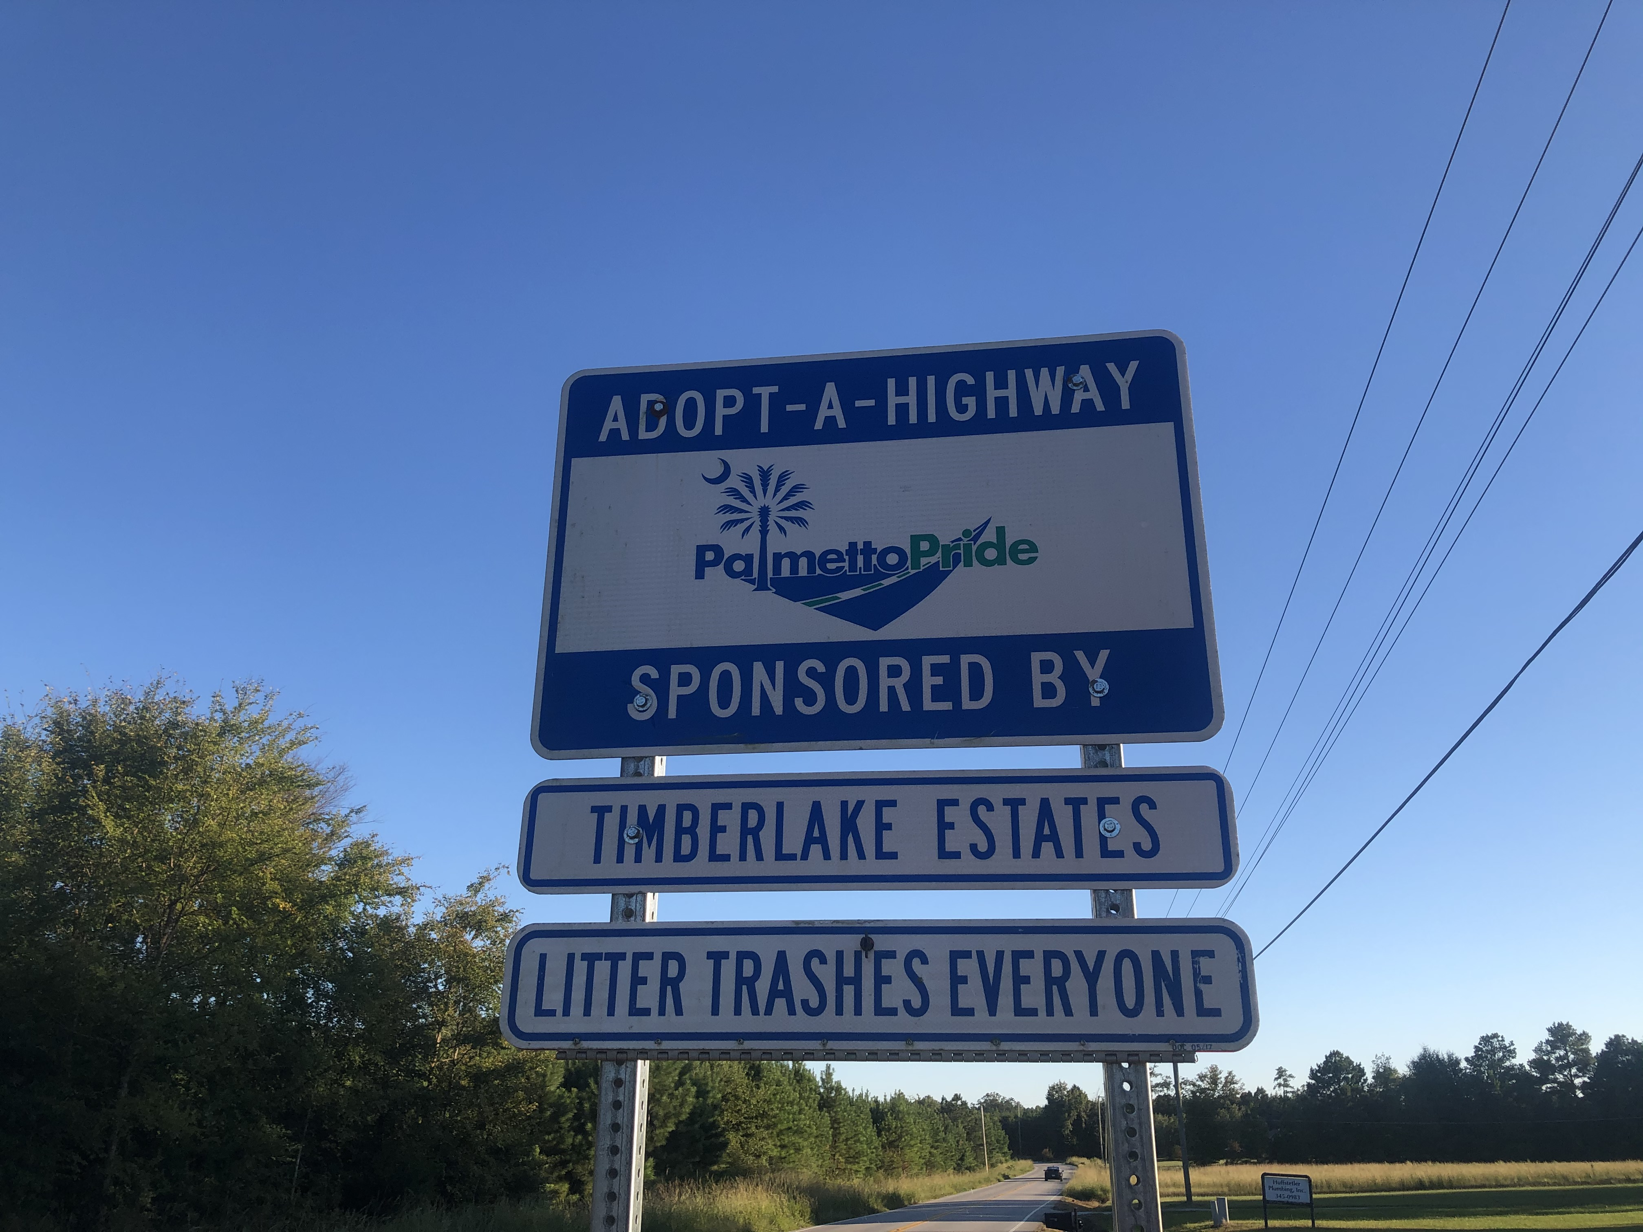
Cleanup Day Policies & Procedures: Finishing Up
Leaving on Cleanup Day
Click on each tab to review what you as a Group Leader must do upon leaving to ensure a fun and safe cleanup!
Bagged Trash
Recycling
Litter Pick Up Sign
Submit Report Card
At the end of the cleanup, close the "Litter Pickup Ahead" sign and remove any temporary “Volunteers Picking Up Litter” signs that you put out.

Slide 53
Cleanup Day Policies & Procedures: Finishing Up
Leaving on Cleanup Day
Click on each tab to review what you as a Group Leader must do upon leaving to ensure a fun and safe cleanup!
Bagged Trash
Recycling
Litter Pick Up Sign
Submit Report Card
It is your responsibility as a Group Leader to complete a “Report Card” after each cleanup and to submit it to Keep the Midlands Beautiful:
Online
By phone
Continue

Slide 54
QUIZ Question #7
Where should group members park their cars when arriving at their cleanup location?
A predetermined location
Anywhere they can
Preferably a parking lot (that the Group Leader has obtained permission to use if needed)
Both A and C
Click on the correct answer.

Slide 55
Correct! Congratulations!
Continue
This Photo by Unknown Author is licensed under CC BY-SA

Slide 56
Please Try Again
Go Back to Question

Slide 57
QUIZ Question #8
Volunteers are encouraged to wear long pants and closed toe water shoes for safety reasons.
True
False
Click on the correct answer.

Slide 58
Correct! Congratulations!
Continue
This Photo by Unknown Author is licensed under CC BY-SA

Slide 59
Please Try Again
Go Back to Question

Slide 60
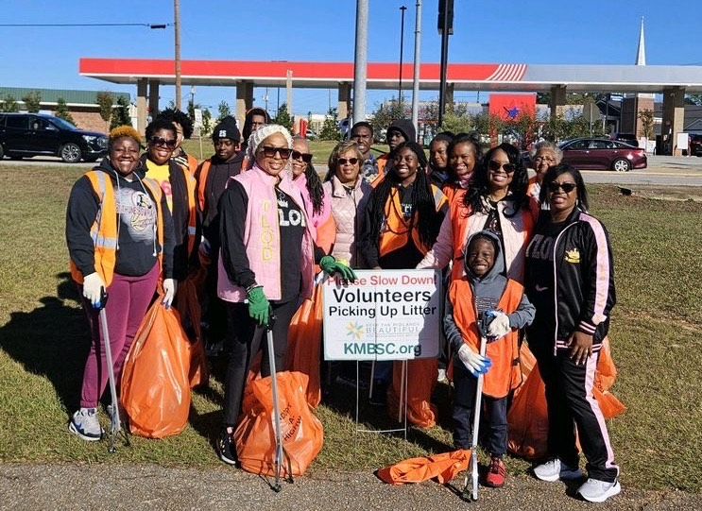
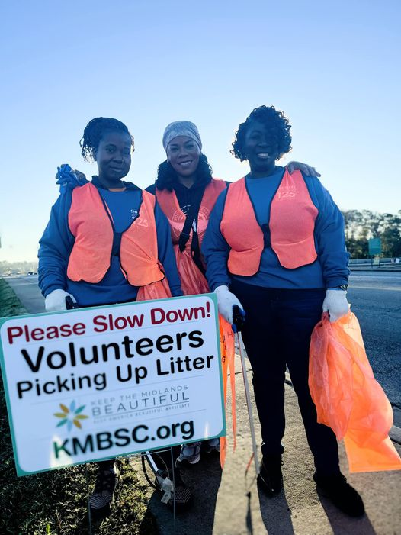
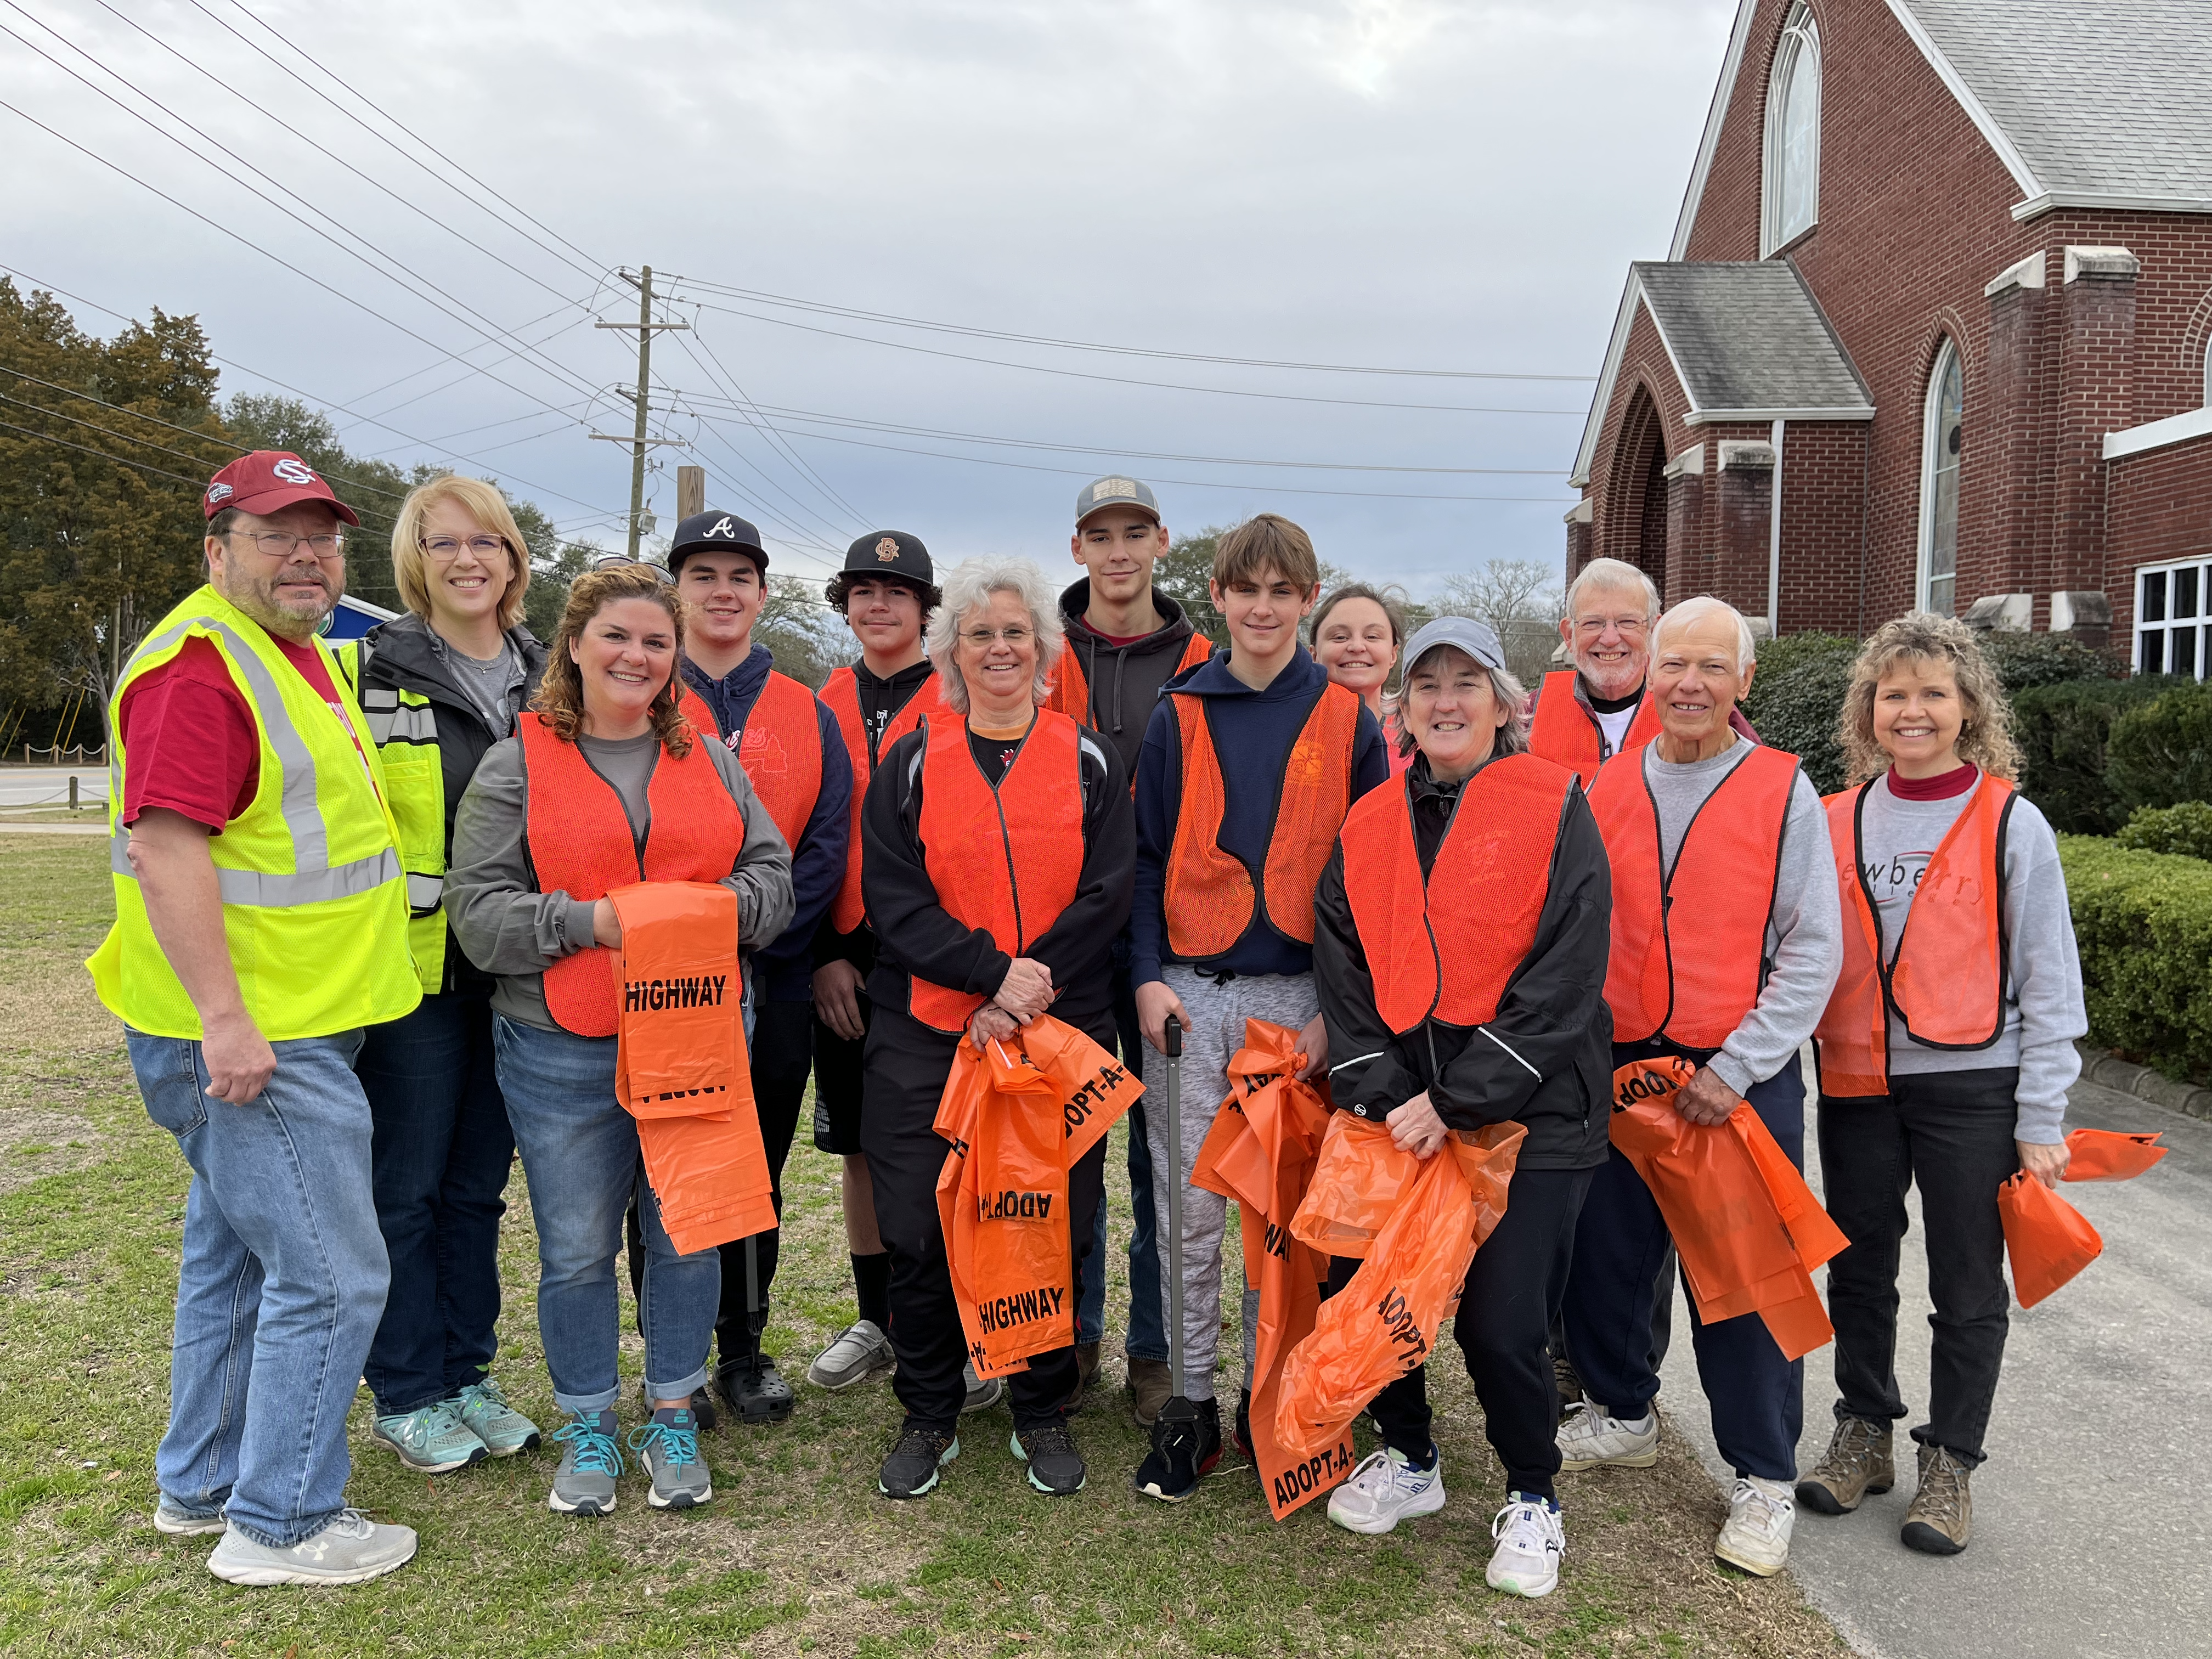
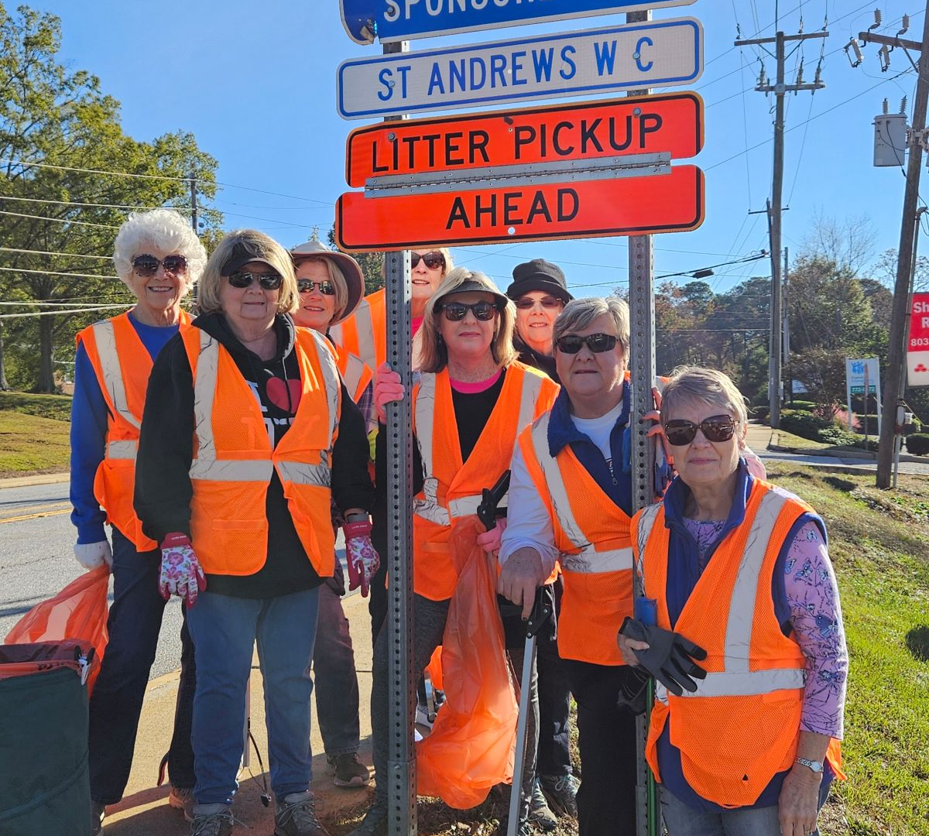
Be creative and have fun!
Continue
Send before and after photos to programs@kmbsc.org

Slide 61
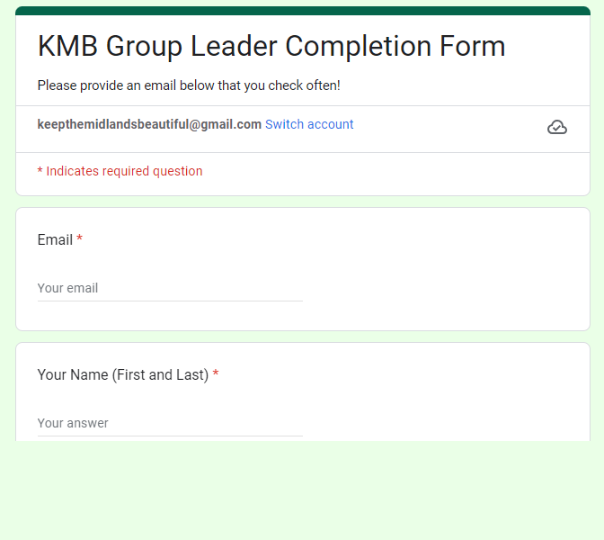

To get credit for completing this course- complete this short form https://forms.gle/aF3XUWzqEgs9KsGv9
Continue

Slide 62
Thank you for volunteering
and for completing this Adopt-A-Highway and Adopt-A-Street safety and orientation course for Group Leaders!
The End

